Slide 1

Diploma in python programming
Meghna Rasheed

Slide 2
Why This Course?
Easy to understand: Python’s readability, non-complexity and ability for fast prototyping contribute to its popularity.
Libraries: Python comes with numerous built-in libraries that are well suited for data mining, machine learning and AI.
Easier, more powerful implementation: With Python, programmers spend less time writing code and debugging errors compared with other languages.
Syntax: Python uses modern scripting and friendly syntax.
Broad support: Python’s support community is large, increasing its popularity even more.

Slide 3
About Myself.
My name is Meghna Rasheed, and I am currently a first-semester student in Software Engineering. I have always been interested in technology and problem-solving, which led me to choose this field of study. I also pursued a Diploma in Python Programming to strengthen my coding skills and build a solid foundation in programming. Through this course, I aim to learn how to write clean, efficient Python code and apply it to real-world tasks such as automation and application development. My long-term career goal is to become a professional software developer, specializing in areas like web development, data science, or artificial intelligence. I am eager to gain hands-on experience, contribute to meaningful projects, and continuously grow in the tech industry.

Slide 4
Overview.
The Diploma in Python Programming is a foundational course designed to equip students with essential programming skills using Python, one of the most popular and versatile programming languages today. The course covers core concepts such as variables, data types, control structures, functions, object-oriented programming, file handling, and error management. Students also gain hands-on experience by working on practical projects that involve real-world applications like data analysis, web development, and automation. This course is ideal for beginners and aspiring developers who want to build a strong base in programming and prepare for advanced learning in software development, data science, or machine learning.

Slide 5
Total Time Spent To Complete This Course.
The course that I took contains 15 modules in each modules there were almost 3-4 video classes. The course was 20 hours course. I took almost 1 week to complete the course.

Slide 6
Benefits of Certificate.
Strong Foundation: Builds essential coding and problem-solving skills for further studies or specialization.
Industry-Relevant Skills: Learn one of the most in-demand programming languages used in web development, data science, AI, and more.
Recognized Certification: Adds value to your resume and demonstrates your coding proficiency to employers.
High Market Demand: Python developers are highly sought-after in various tech industries.
Competitive Edge: Gives you an advantage in job and internship opportunities by showcasing practical programming experience.
Hands-On Learning: Apply your knowledge through real-world projects and practical tasks.
Strong Foundation: Builds essential coding and problem-solving skills for further studies or specialization.

Slide 7
Course Topics.
Getting started
Displaying text
String variables
Storing numbers
Working with dates and times
Making decisions with code
Complex decisions with code
Repeating events
Repeating events until done
Remembering lists
How to save information in files
Reading from files
Functions
Handling errors

Slide 8
Why Python?
There are a lot of programming languages out there .
Python is one of the easier ones to learn.
There are lot of free tools out there you can use to code or learn Python.
And as a bonus once you learn how to code in one programming language it will be easier to learn another programming language like JavaScript ,C++ etc …

Slide 9
Does anyone really use Python?
Industrial Light and Magic uses Python to help with image processing and lighting special effects.
ForecastWatch.com use Python to help with weather forecasts.
DevNet uses Python to aggregate news feeds.
A student in the England made a desktop dinosaur roar every time it was mentioned on twitter with Python and Raspberry Pi.

Slide 10
The software used in this course to write the Python code is Visual Studio + Python Tools for Visual Studio

Slide 11
There are actually a lot of different flavors of Python : IronPython, Ipython, Cpython, PyPy, Jython, Canopy, Anaconda etc… Here Cpython interpreter with Python 3.4 is used.

Slide 12
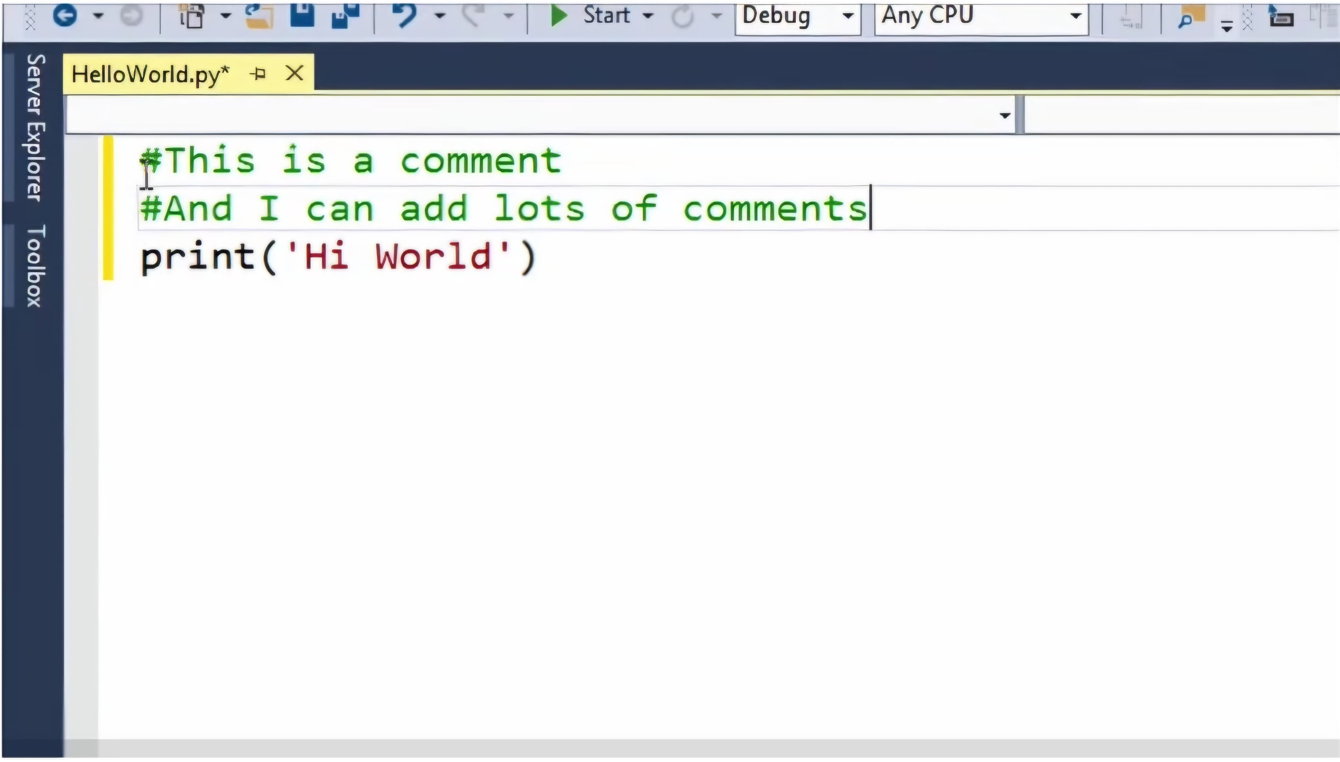
In Python we use # to indicate comments

Slide 13
The Basic principle of programming is that it is problem solving.
Python is one of the easier programming languages to learn , and many of its tools are free to download and use
Once you learn how to code in one programming language it will be easier to learn other programming languages, as the principles are the same.
There are a lot of different variations of Python, IronPython, Ipython,Cpython to name a few. Most of Python’s variations only have some syntax differences but not too many.
Comments are very useful in your code to help you or someone else understand: what your program does, what a particular line or section of code does, why you chose to do something a particular way, anything that might be helpful to know if you or someone else looking at the code later and trying to understand it.
The #is the symbol to indicate using comments in python.

Slide 14
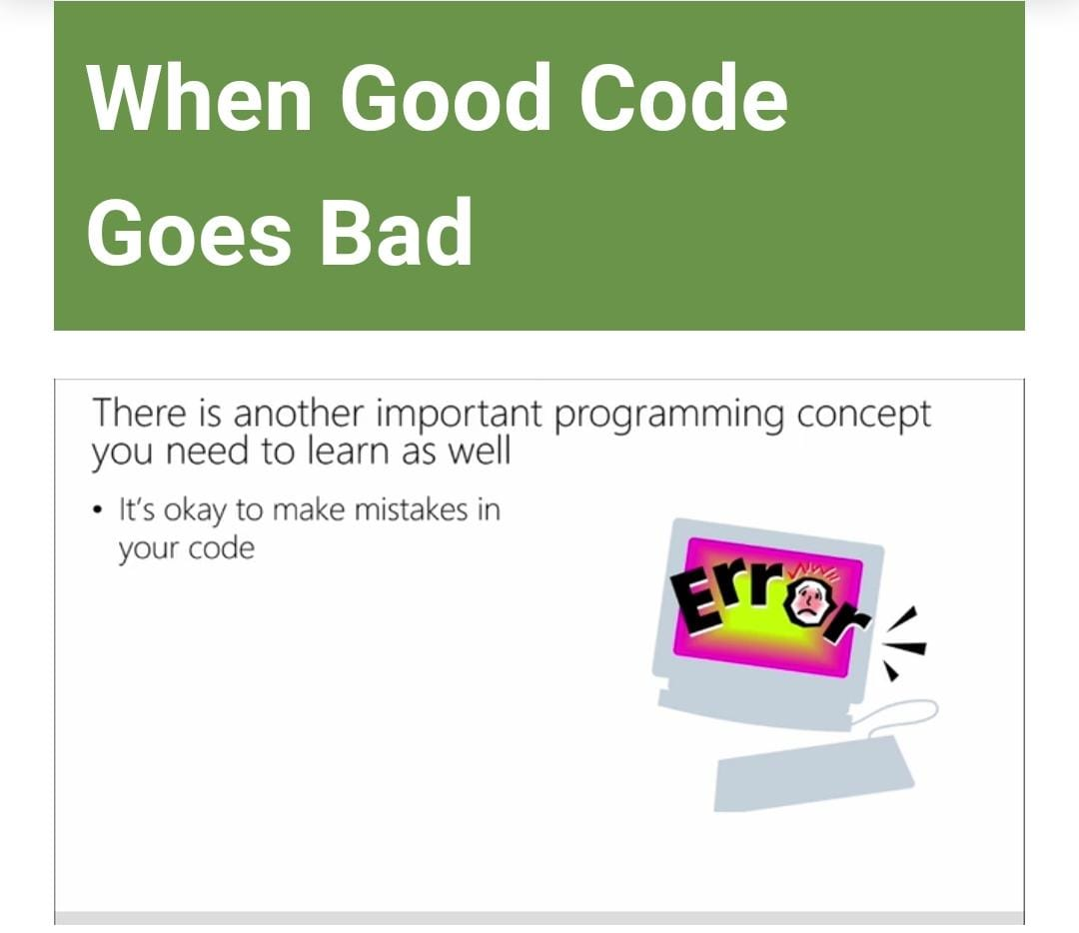
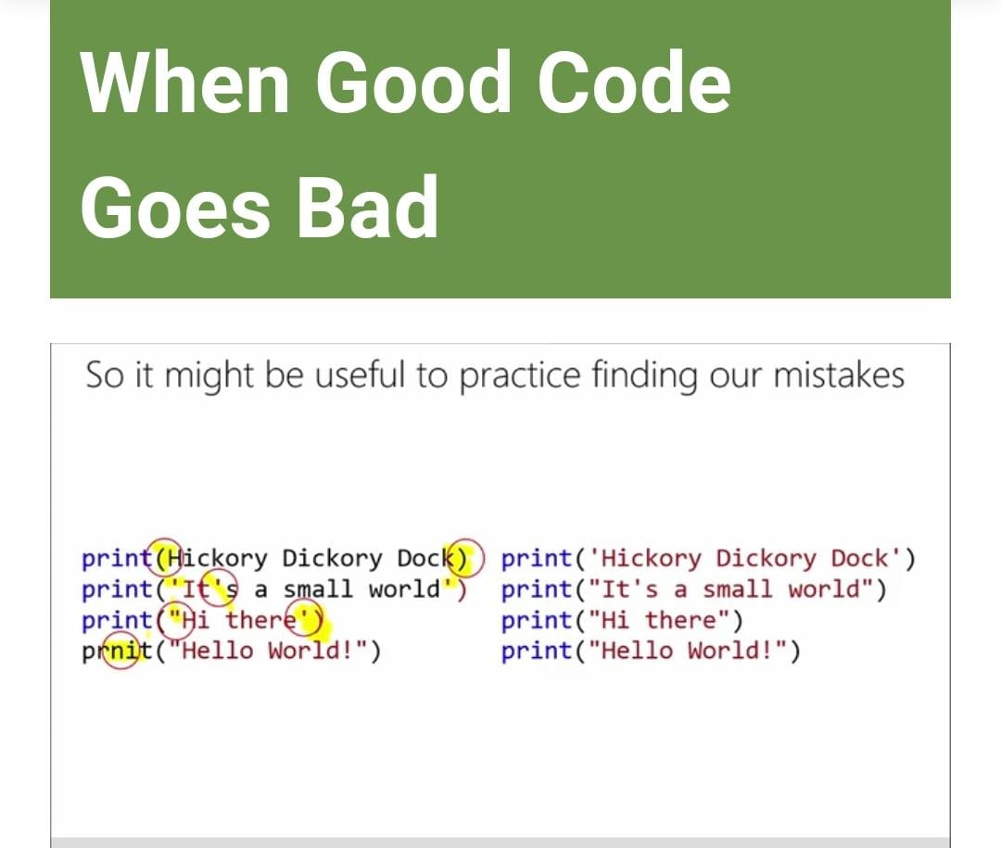
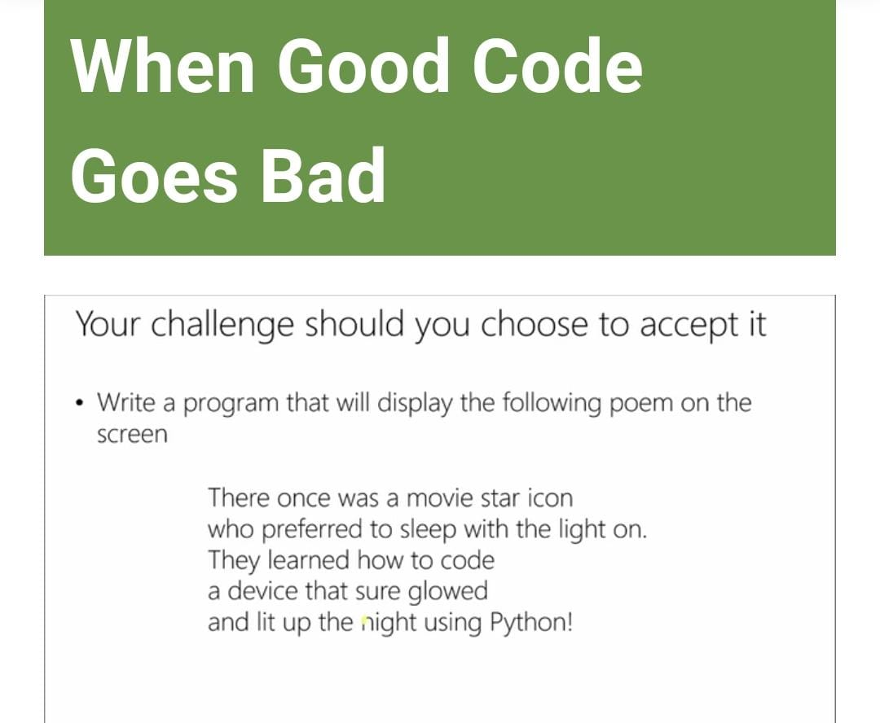
One of the simplest but most important thing you need that ability to do in programming is display text.
For displaying text in Python you use the print() statement.
Your text inside prints brackets must be enclosed with quotes, Python accepts both single and double quotes.
For printing on multiple lines you could use multiple print statements or you can use \n which declares a new line for the text that follows it.
You can use tripe quotes for the text to display , as you have typed it into the editor this is not a recommended method as most other programming languages don’t support it.
You will make mistakes when programming all programmers make mistakes from trying mistakes to logic mistakes, it is not something to stress over.
Recommend solutions to fixing mistakes you can’t find or having trouble with: Walk away and come back to it, have another coder look at it, step though your code with your debugger.

Slide 15
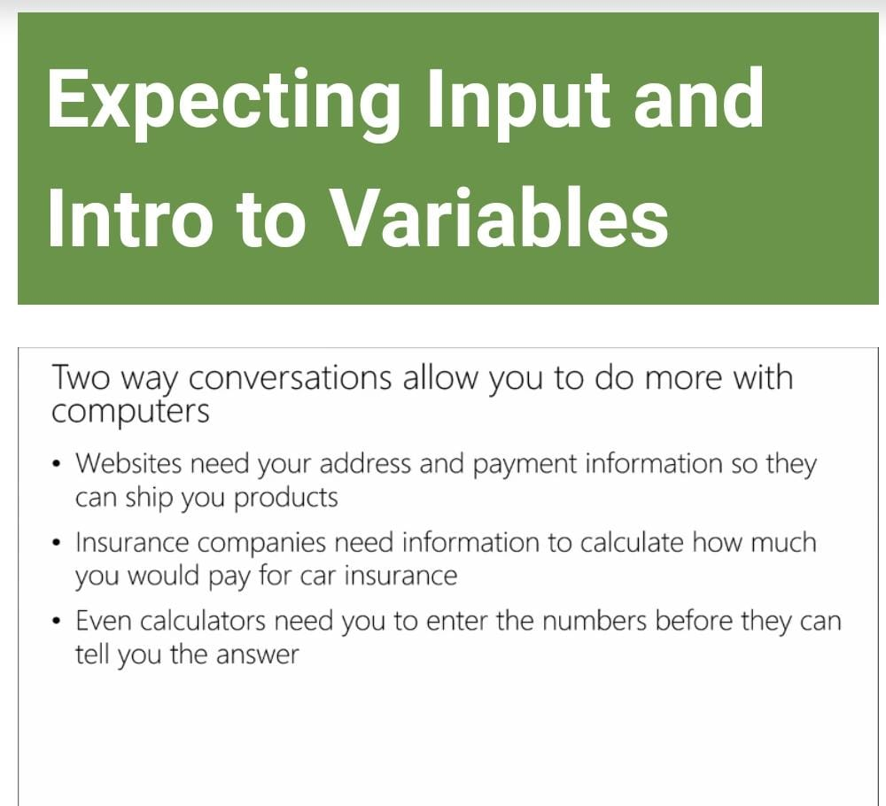
Input.
For getting input from the user inn Python you use the input command .
Input is broken into two parts:
-A message you specify to display to the user .
-User input .
You will use a variable to record the value entered by the user.

Slide 16
Variables.
A variable is a place holder all object you can store a value or piece of data and come back to it later. Variables are named storage locations or objects that contain data you can access later or as you need to. Variables and strings can be combined with the + symbol , you often need to add punctuations or spaces to display the output properly.. Variables contents can be manipulated with functions, for example you can use the lower function to change a string to all lower case. Functions are a section of a program that performs a specific task .

Slide 17
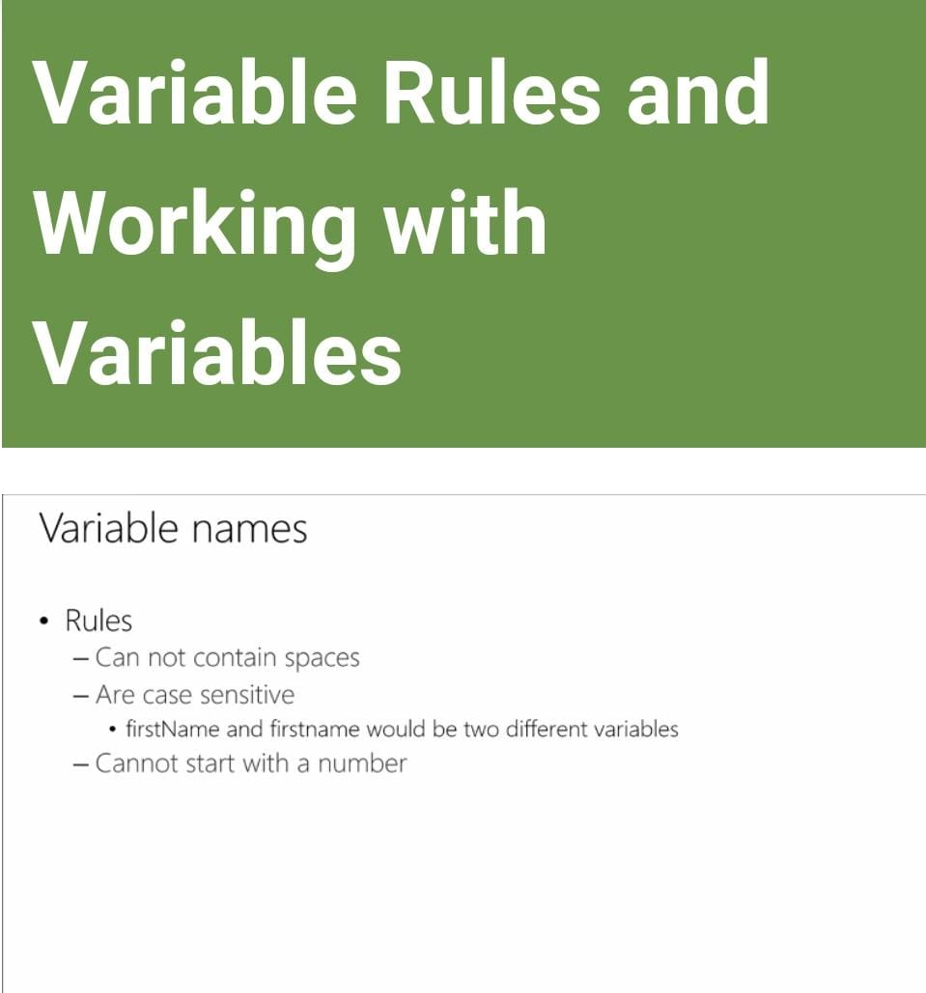
Naming Variables And Guidelines.
Variables are named by you, a variable can have their value change later in any stage of the code. When naming your variables there are rules :
You can’t have spaces
Variables are case sensitive
Cannot start with a number
Guidelines for creating variables:
You should use names that make sense or relevant to what they are being used for, but that are not too long.
Use a casing scheme, Pascal casing and Camel casing are two common schemes used.

Slide 18
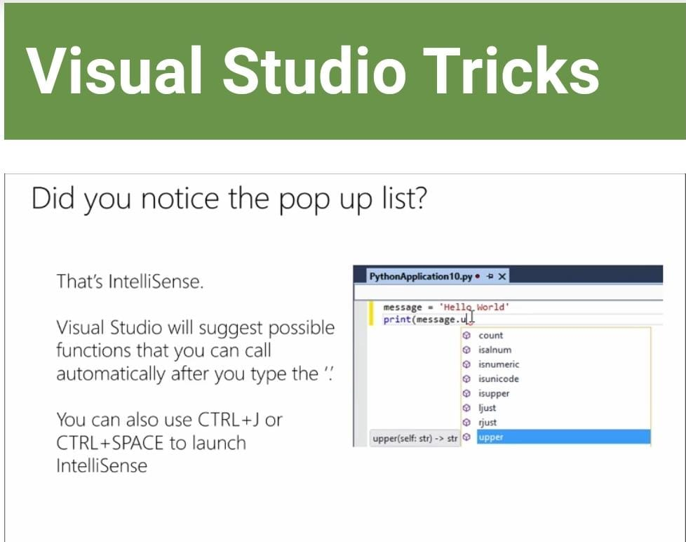
Visual studio has a built in feature called intellisense, which will suggest possible functions that you can call after you type the full stop”.” . Programmers don’t memorize all the functions , when they need these functions they use intellisense to prompt them, they have or get documentation and they can search on the internet. Intellisense doesn’t always prompt you with a function, because it might not know what you are going to store in the variable. To get around this you initialize your variable, which means when you create It you give the variable a value.

Slide 19
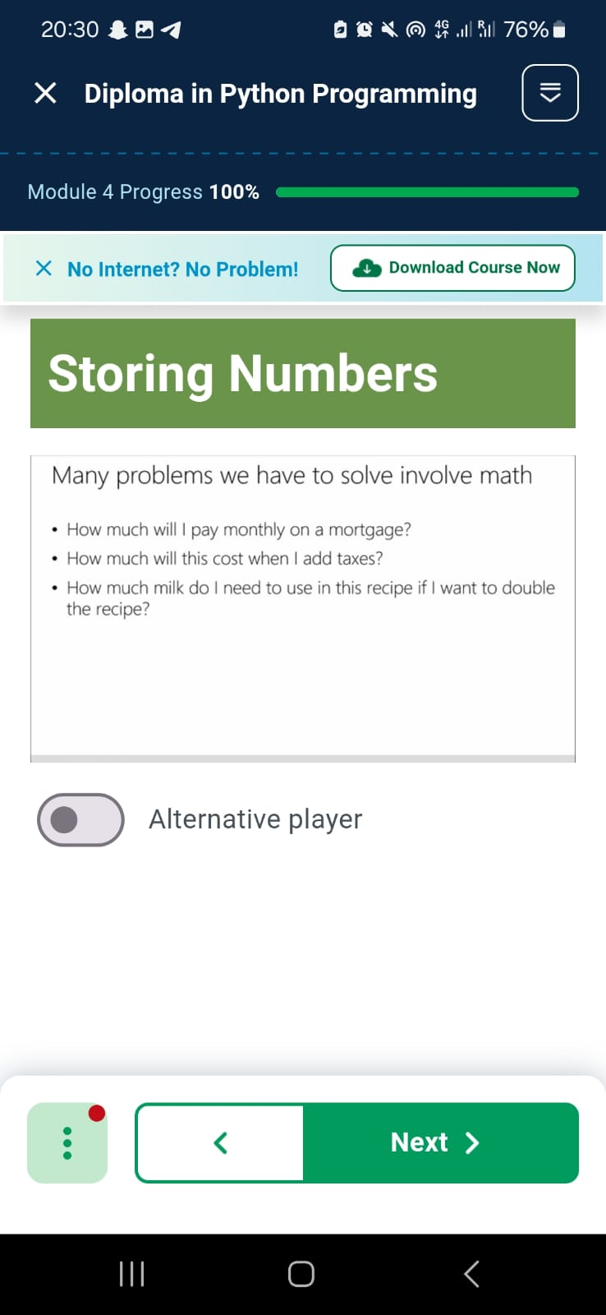
Storing Numbers.
When working with variables remember you can store numbers as well as strings, the quotes around the text indicates a string if you want to assign a numeric value to the variable you simply enter the number. You can perform math operation on variables containing numeric values, the operation symbols for maths in programming are slightly different but many are the same.
Common math operations:
+Addition, -substraction, *Multiplication, /division, **Exponent, % Modulo
The math rules of order operations are the same in programming as it is in normal mathematics.

Slide 20
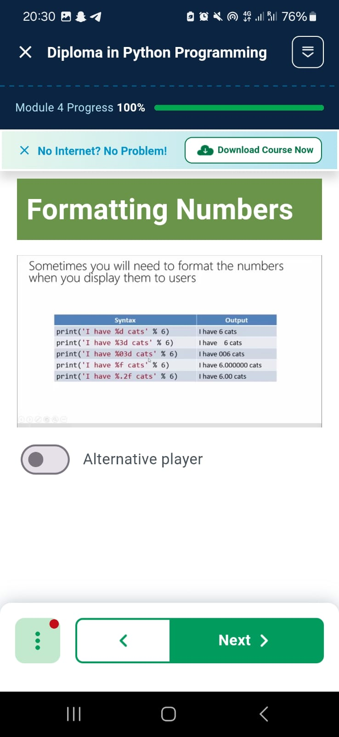
Formatting Numbers.
The +symbol signifies addition in math and for combining two strings together, and will not allow you to add a numeric value to the end of a string. Therefore, you put a place holder in your string and after you close off your string you specify the value you want to put in the place holder.
There are different formats for the place holders from assigning the amount of decimal points to leaving spaces in front of your values. You can also use a Format method to format numeric values.

Slide 21
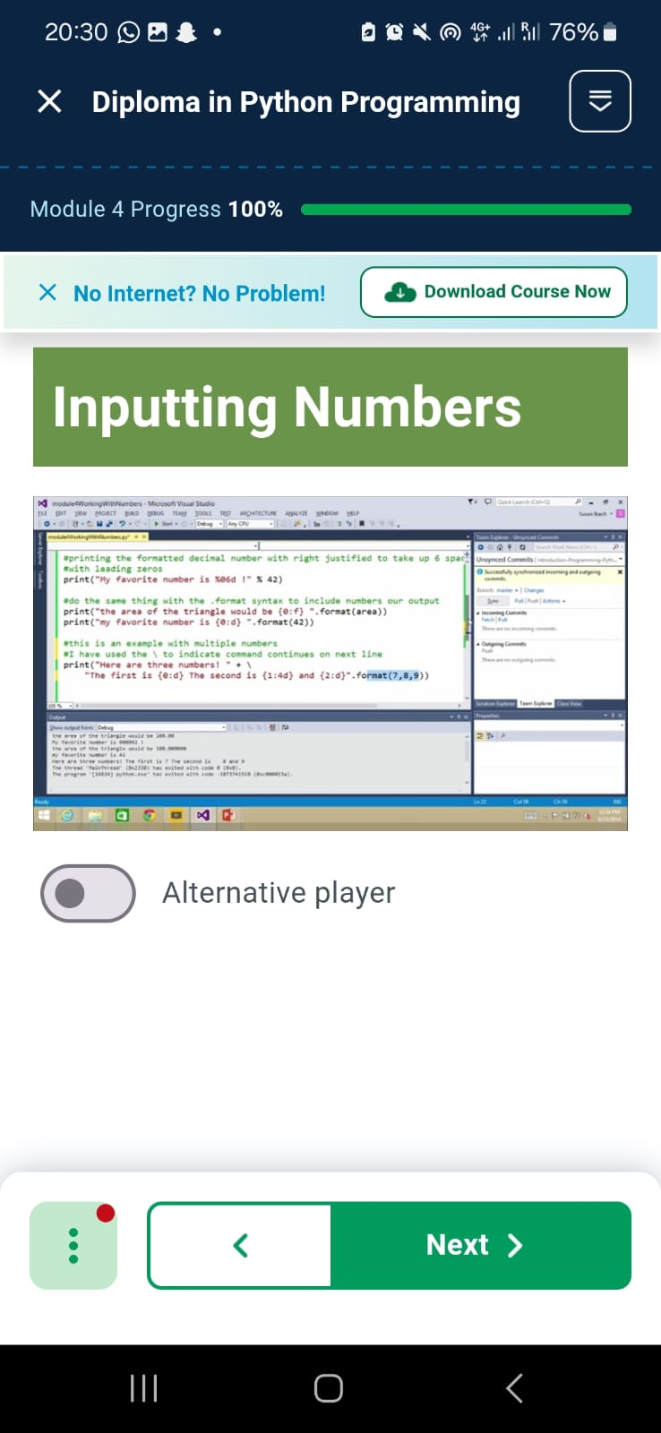
Inputting Numbers.
If you have more than one file in Visual Studio project you will have to specify which file you want to run, or assign the file you are working on as the startup file, the default startup file is the first file created. Setting up user input is similar to setting up input for strings however the input function by default reads you input as a string so you need to convert your input into a numeric value.

Slide 22
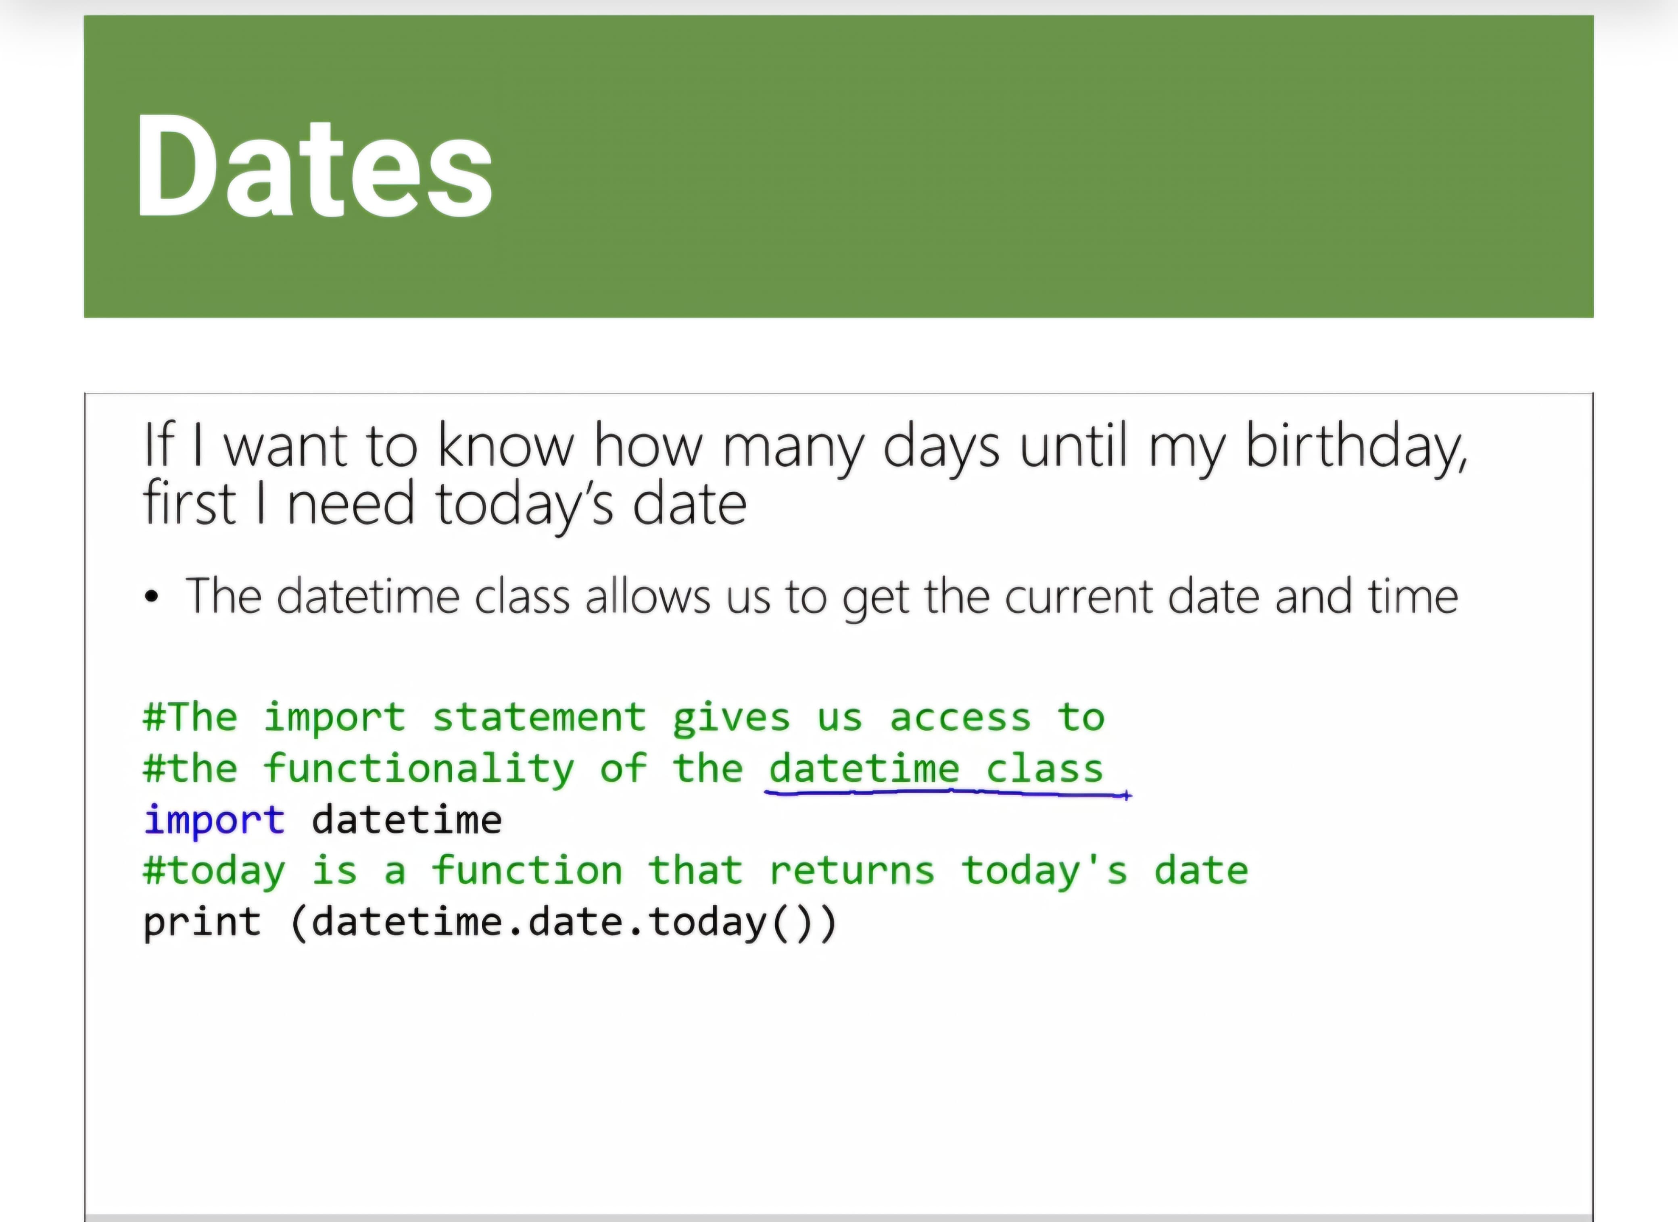
Dates.
For working with dates you will need to import the date library into your program. A library is a collection of precompiled routine and methods for you to use in your program.
Import is a function for making objects and libraries available to your program.
Without importing libraries ,certain functions wont be available to you, they wont even show up on the InteliSeense.

Slide 23
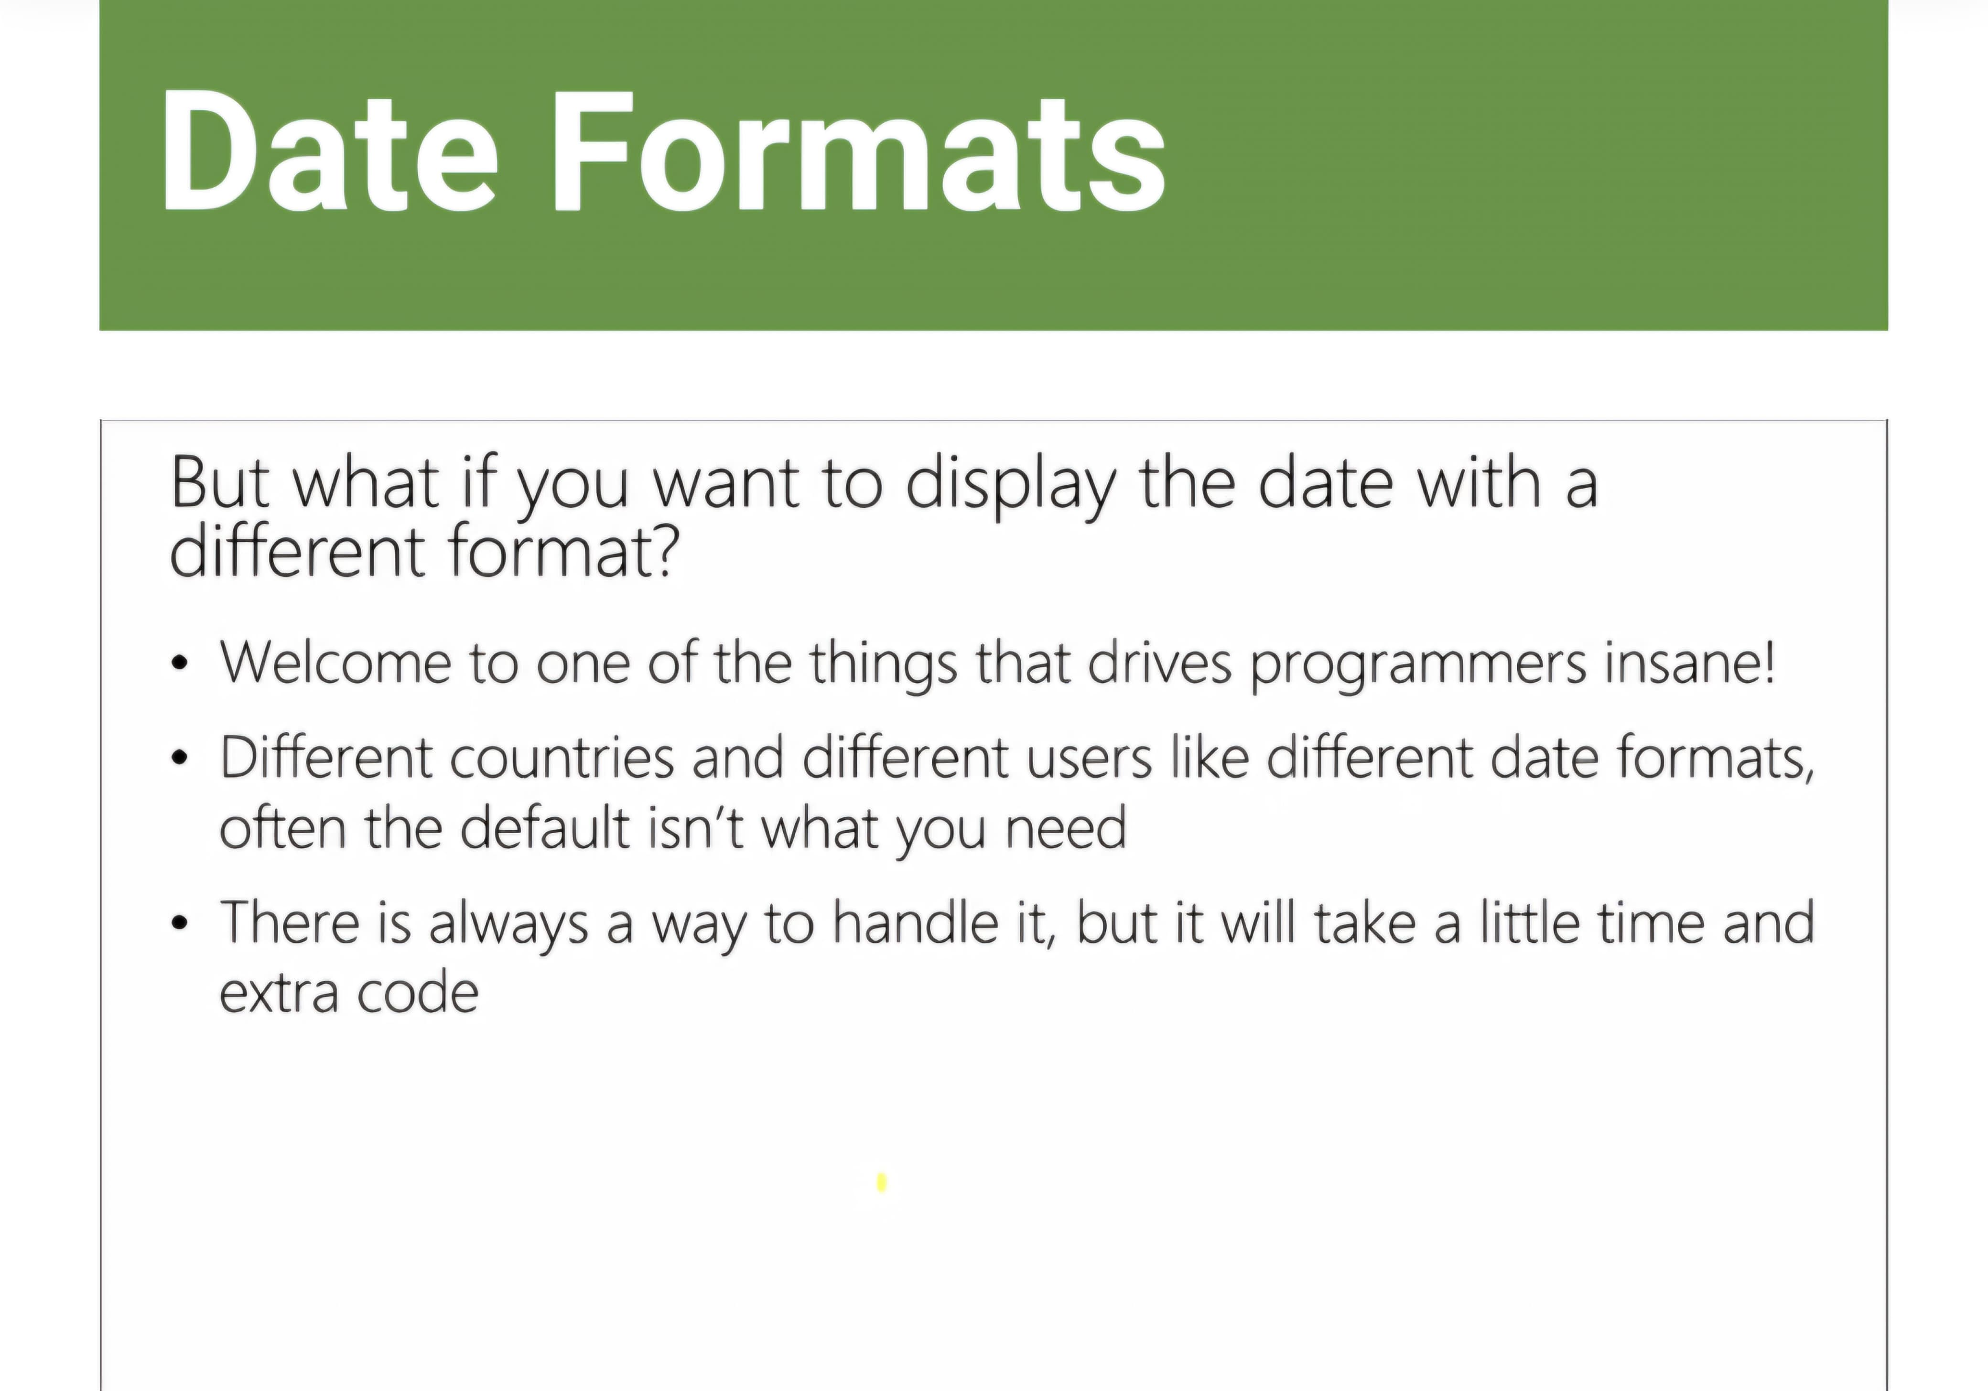
Date Formats.
The format of your date is important as different countries and companies have different date formats. The default format is Year-Month-Day.
In python you use strftime function to format dates, it takes in the parameters; %d for day, %b for month, and %y for year.
There are alternate parameters for the function if you want to display the date in different formats such as the full year typed out.
If your program uses input to take in a date you will need to convert it to a date datatype, the strptime function allows you to do this.

Slide 24
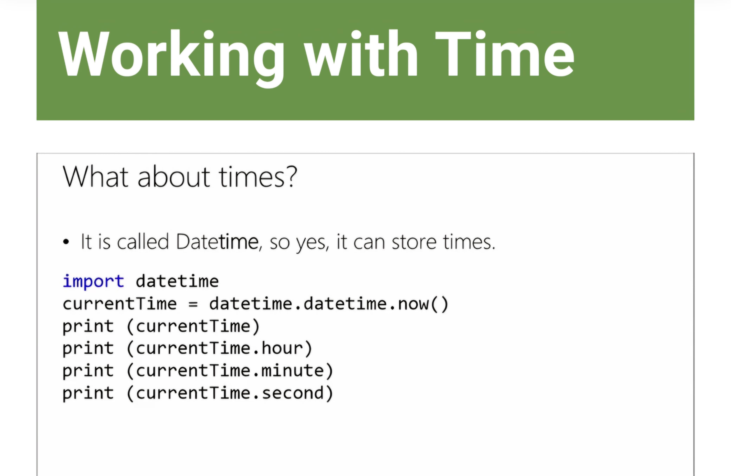
Working With Time.
For working with time you use the same library as date as the library is called datetime.
The function strftime can also be used to format time the same as for dates but the parameters are specific to time.

Slide 25
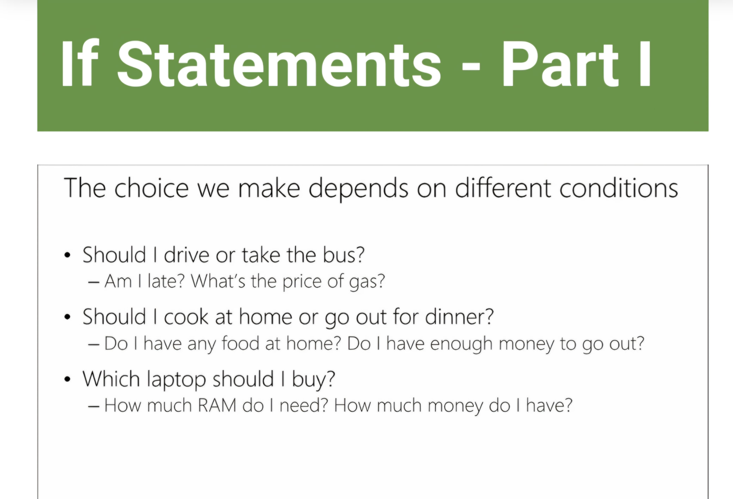
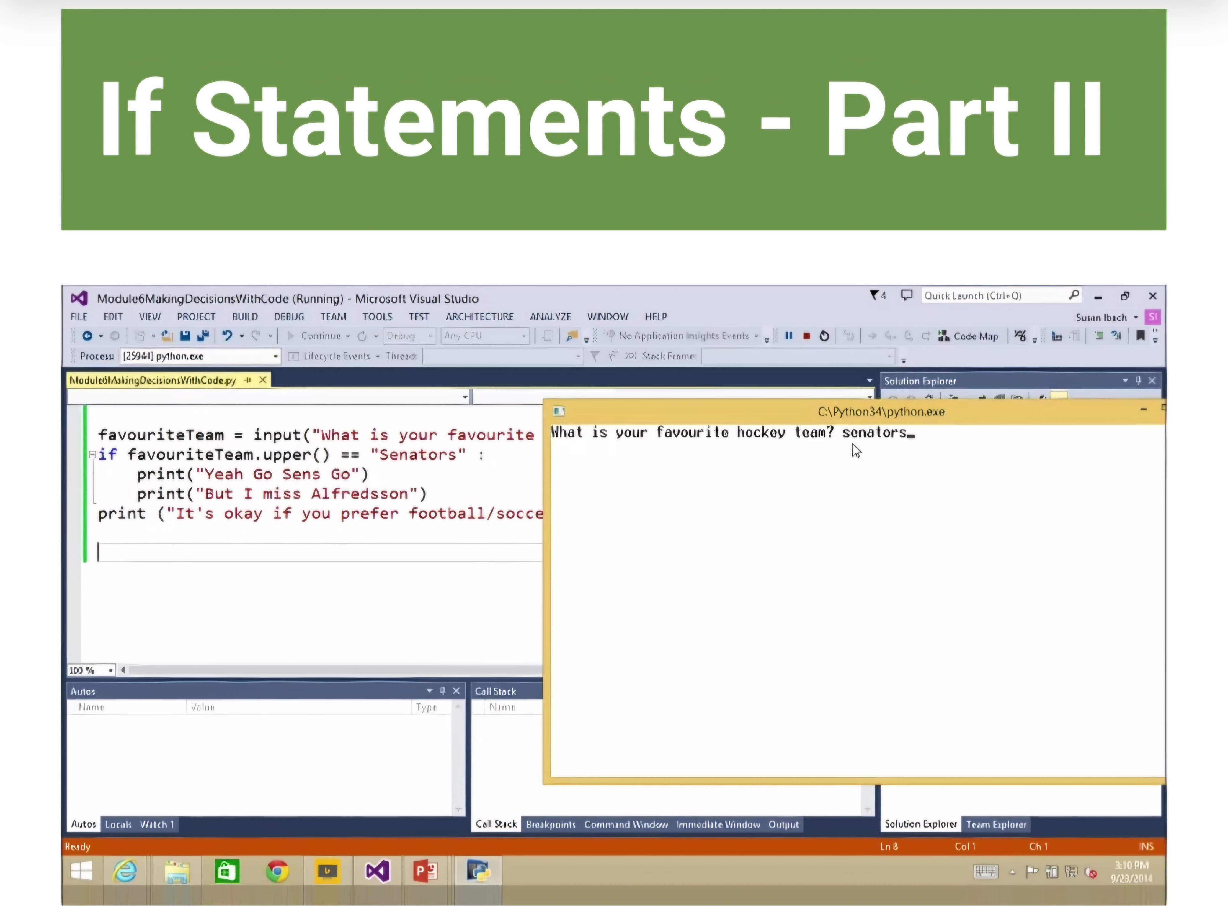
If Statements.
When solving problems with your code, your code will need to make decisions or check conditions for this you use and if statement or an if else statement.
Constraints for checking your if statements:
== is equal to
!= is not equal to
< is less than
>is greater than
<= is less than or equal to
>= is greater than or equal to
Convert both of them to upper or lower case, as python is case sensitive and will not properly work less both are the same case. There are generally two different ways to write an if statement you should always consider which method makes the most sense and is the simplest.

Slide 26
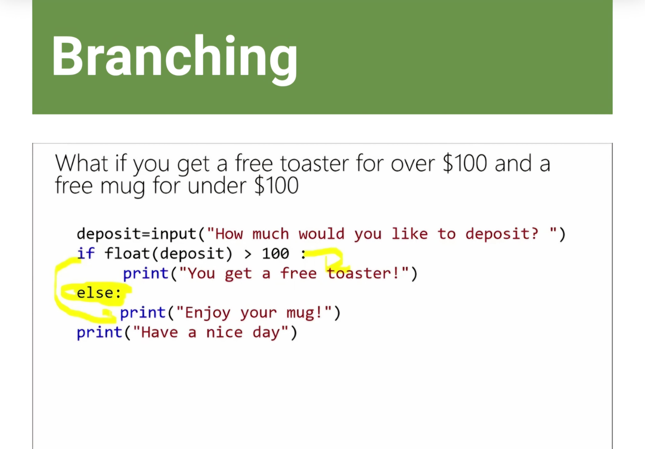
Branching.
Branching is when your if condition is not true, so something else happens. A Boolean variables is one that holds the value true or false. Code in an else statement is only executed if the condition is not true.

Slide 27
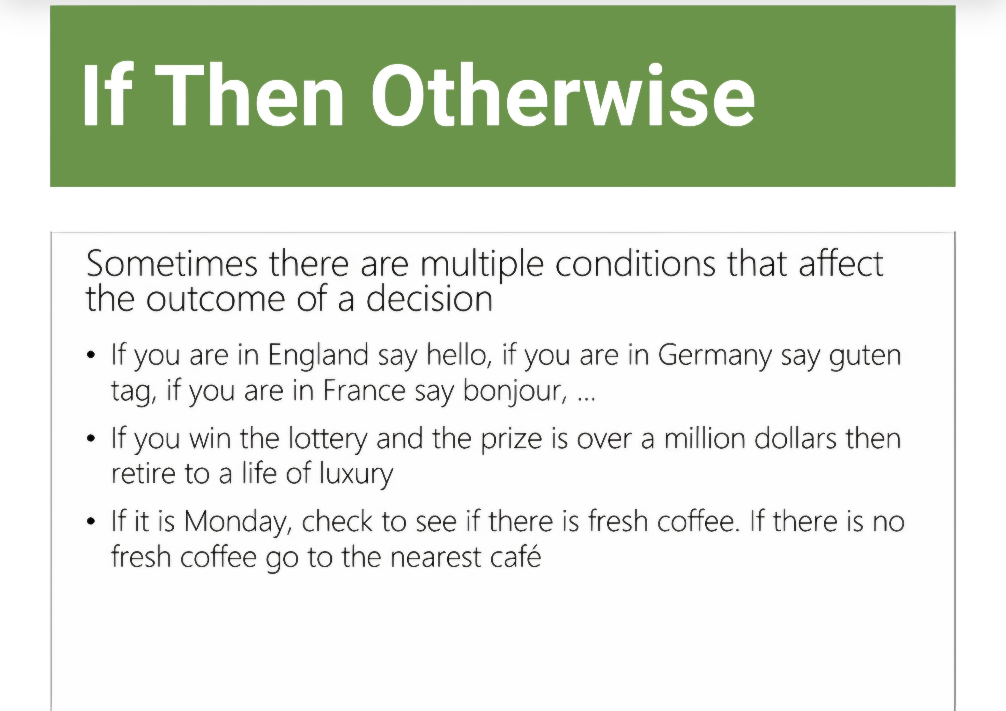
If Then Otherwise.
For checking if conditions are true sometimes there is more than one or two conditions that will affect the outcome, for this we use a elif statement to check the different condition. Ordering of your elif statements is important to be aware of and to test, as your first condition will be tested if that is true then it won’t check the rest.

Slide 28
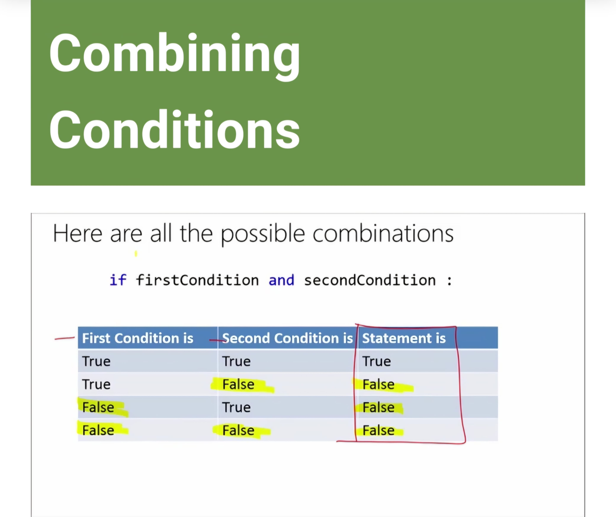
Combining Conditions.
For combining conditions in you if statement or in functions you use the logic operators AND, OR.
For AND both conditions have to be true
With OR either condition has to be true.
You can combine and + or statements using the\.
There is an order of operations the same as in maths so if you are combining an and & or statement the and will be performed first, the best way to avoid this is to use parentheses to make sure you perfume each statement separately.

Slide 29
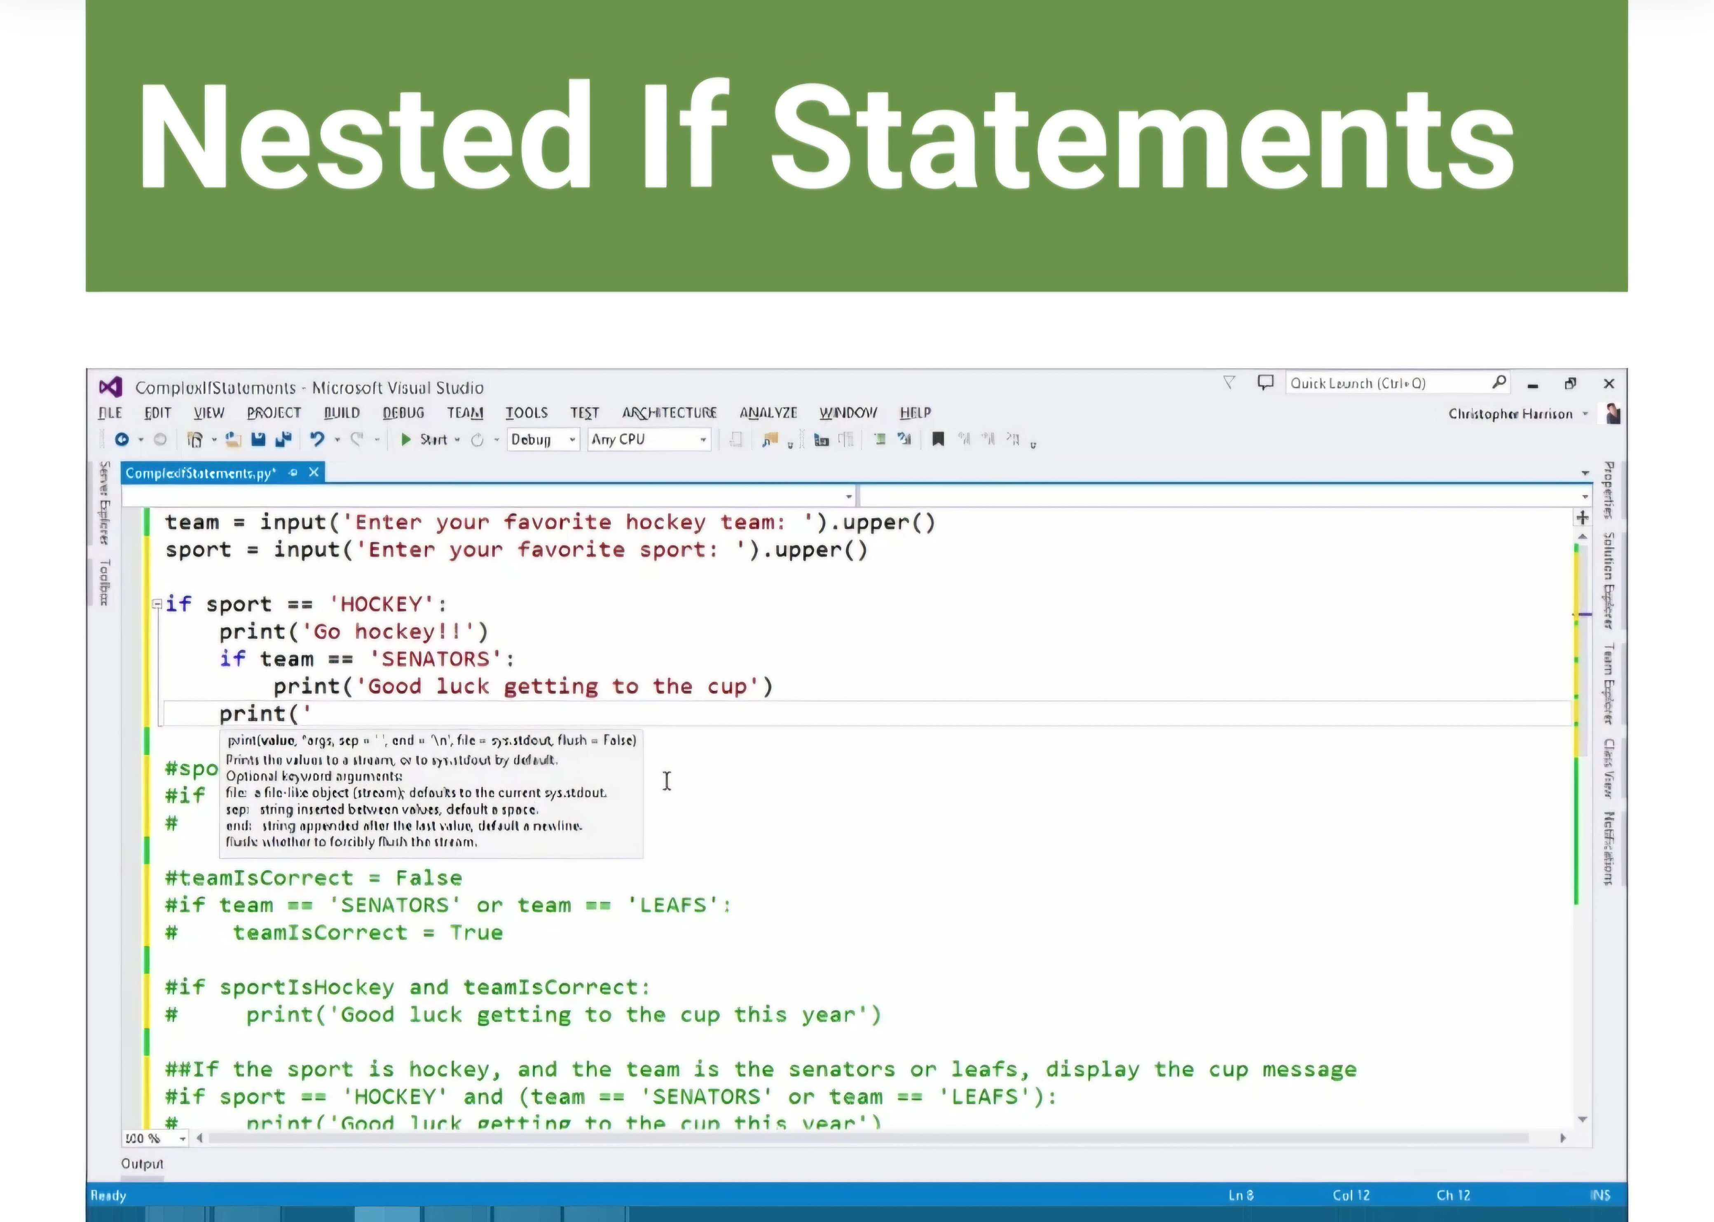
Nested If Statements.
The nested if statement is an if statement within an if statement.. The indent of the code indicates which line is part of the if statements.

Slide 30
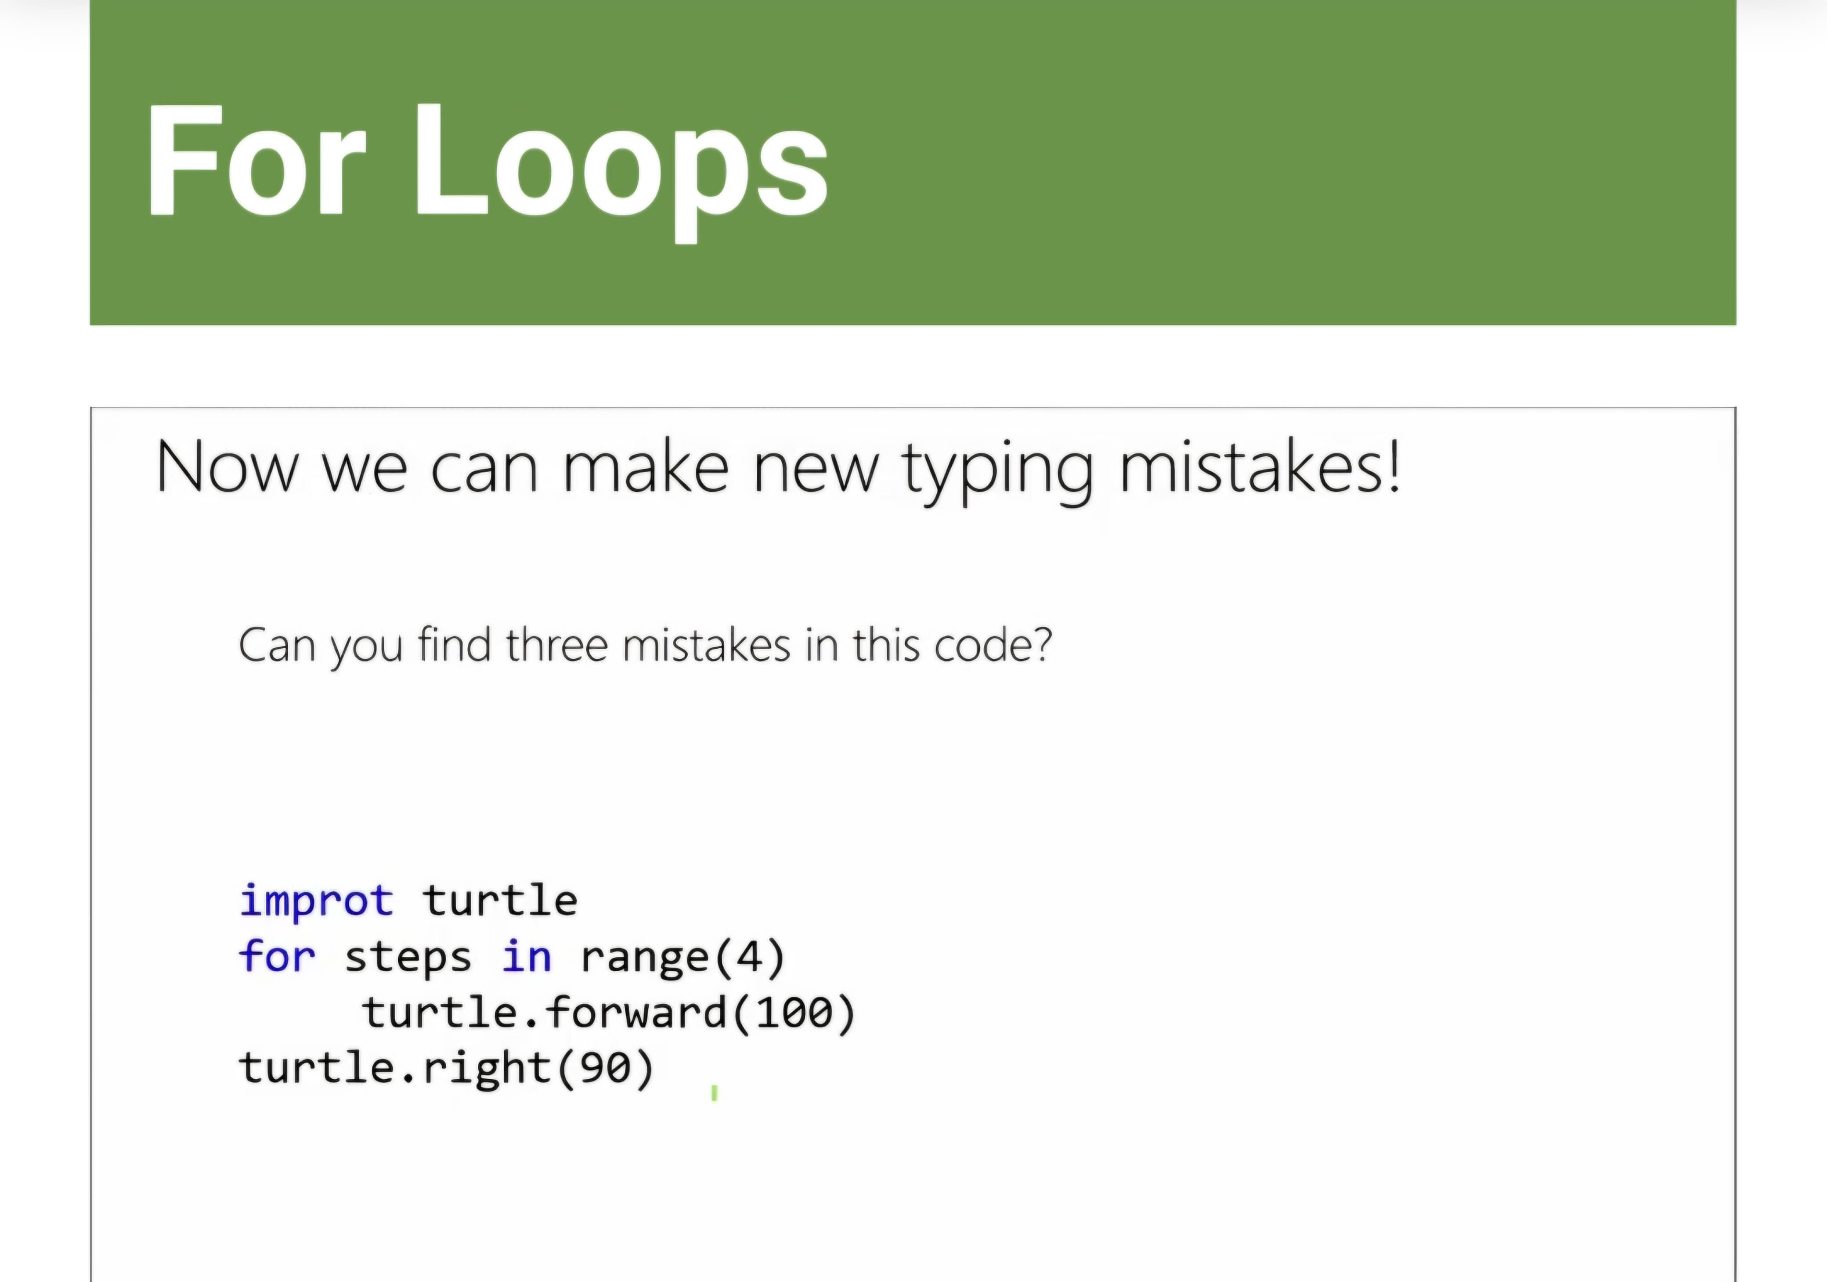
For Loops.
Turtle is a library you can import into your program to draw lines in your program. Loops allow you to repeat the same line of code as often as you want. For Loops are generally used when you have a piece of code you want to repeat a number of times. Only the code that is indented in your for loop is repeated.

Slide 31
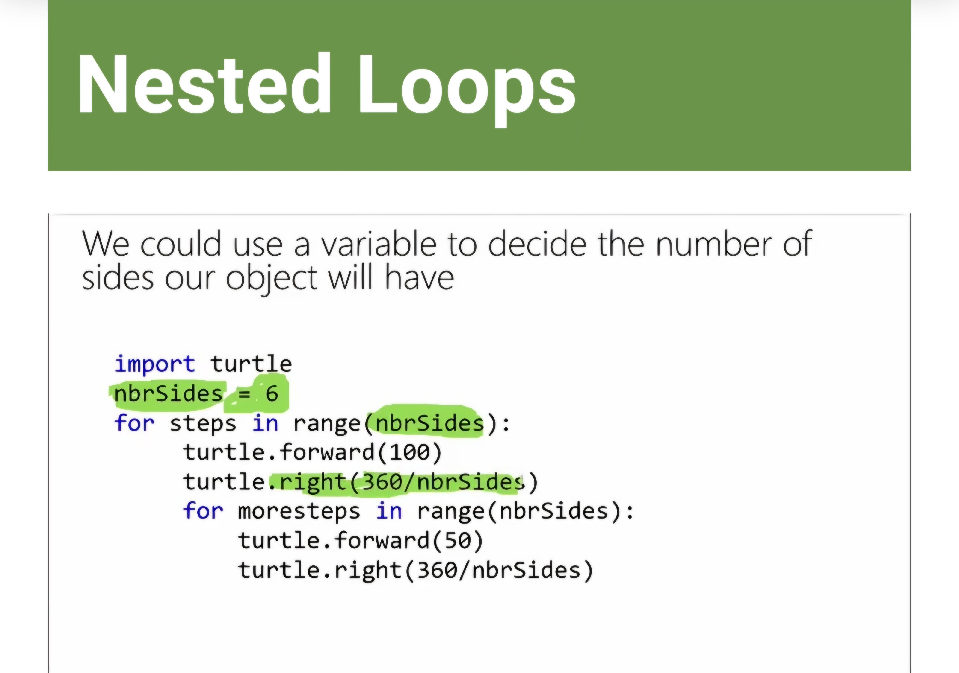
Nested Loops.
A nested loop is one loop inside another loop, what will happen is the outside loop will execute the number of times you have specified so the number of times its specified each time the outside loop is run. A variable can be used as the condition for your loop, this is useful if you need to change a value later.

Slide 32
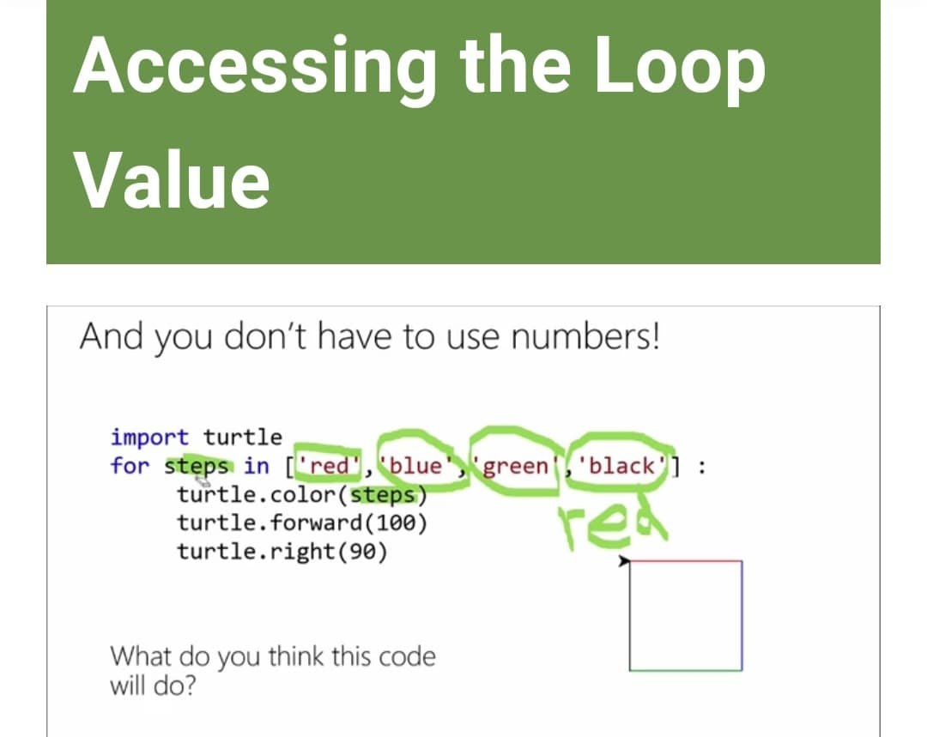
Accessing the Loop Value.
You can access the steps in a loops range by having the loops count from one but as most programming languages count from 0, you will be one less than the highest value in the range if you count from one. You can tell your for loop exactly what or how many values are in the for loops range.

Slide 33
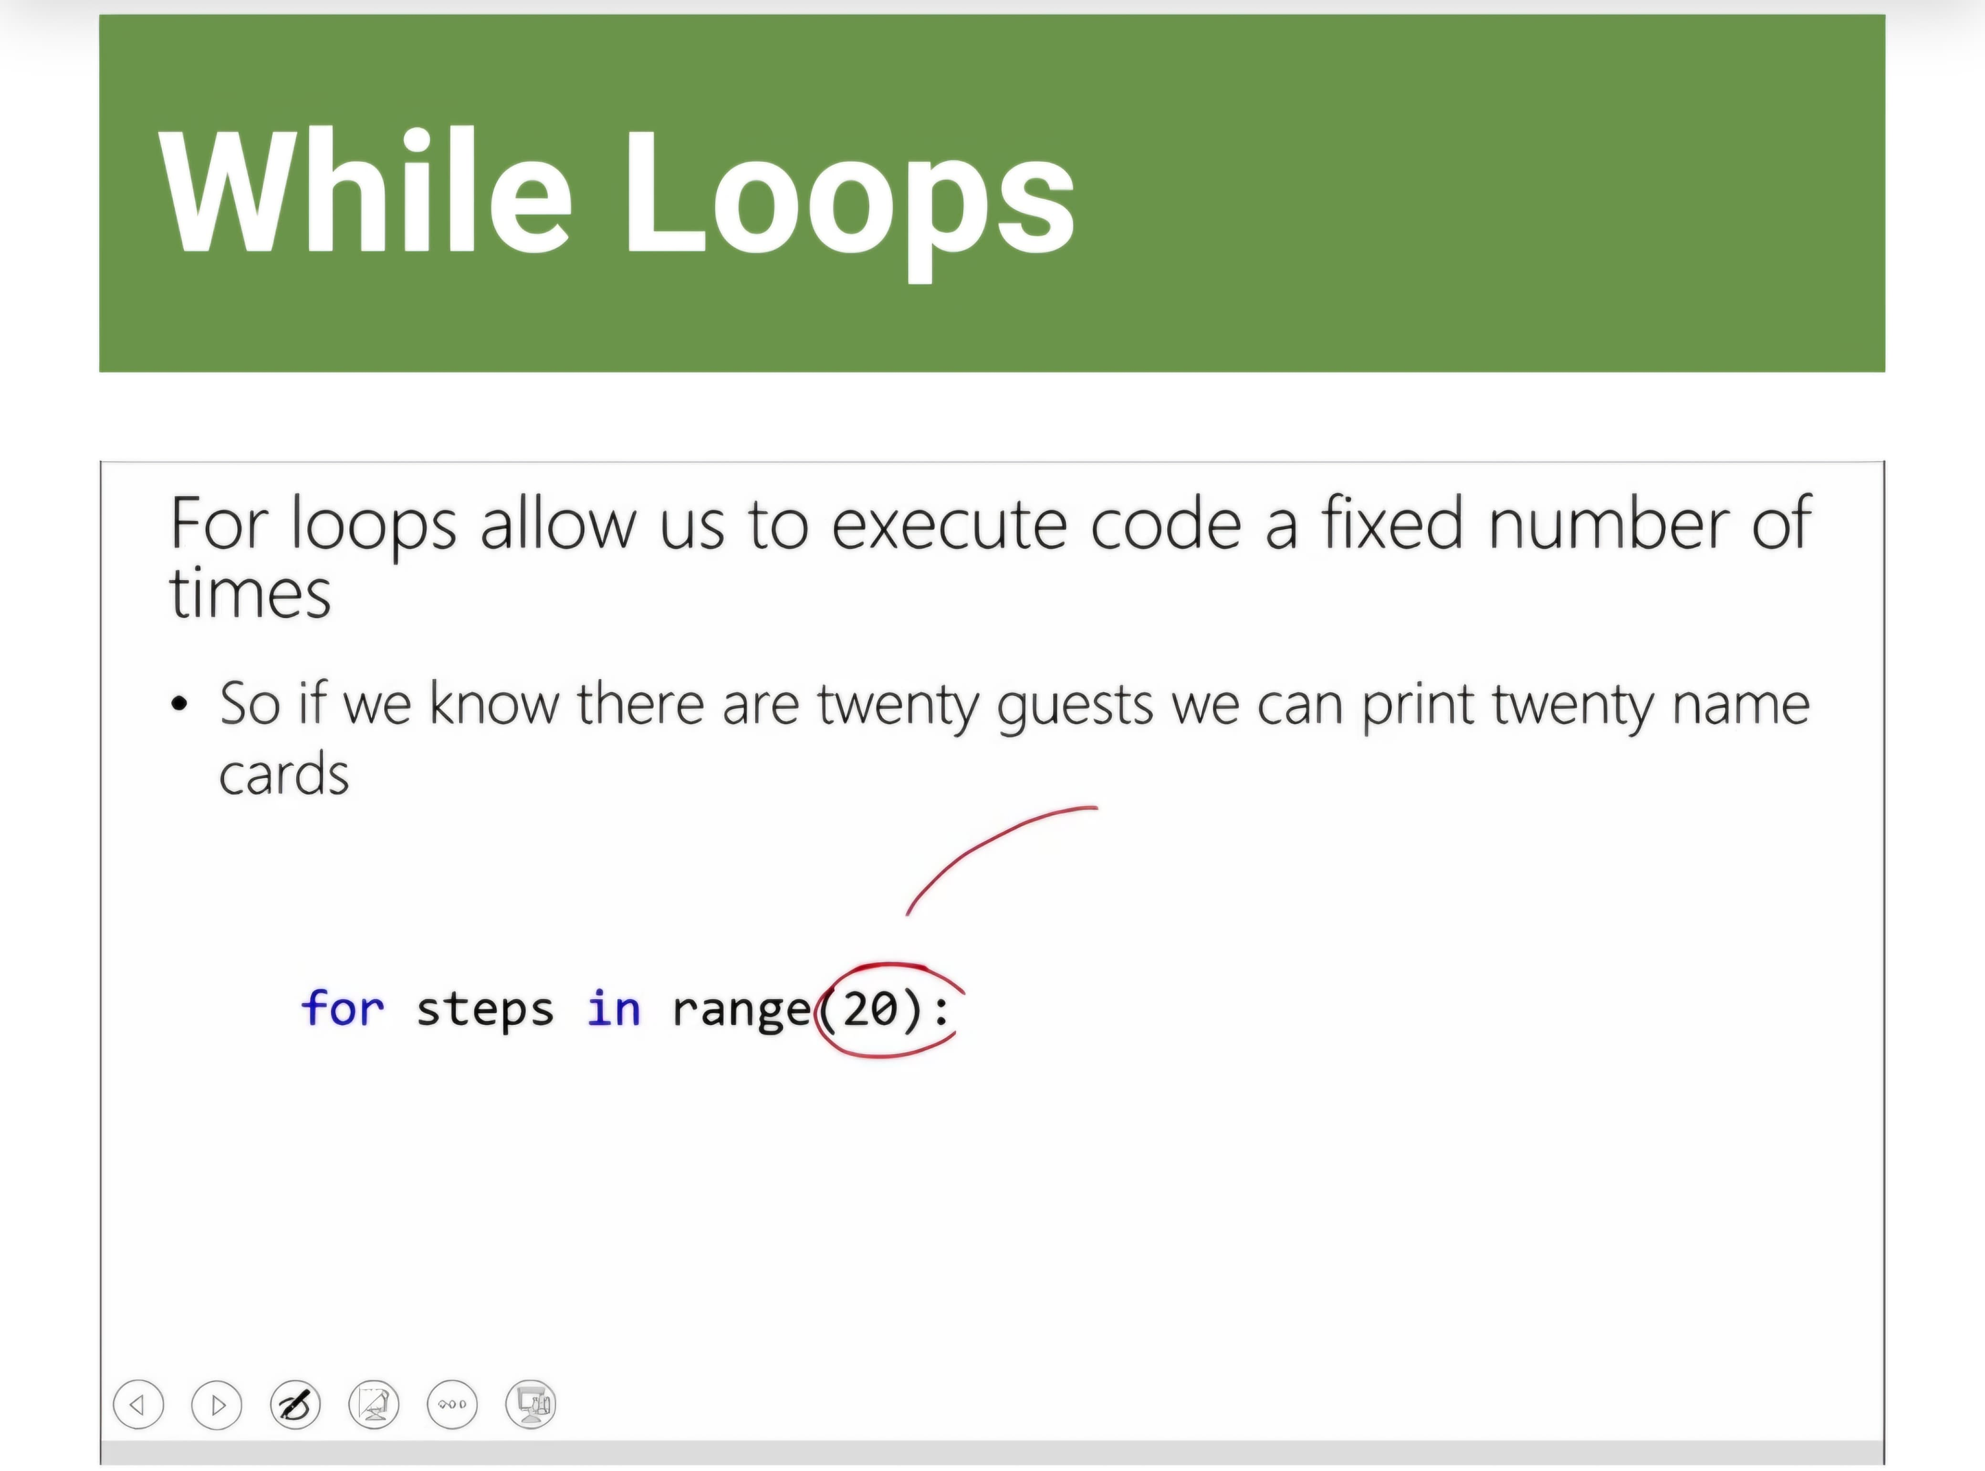
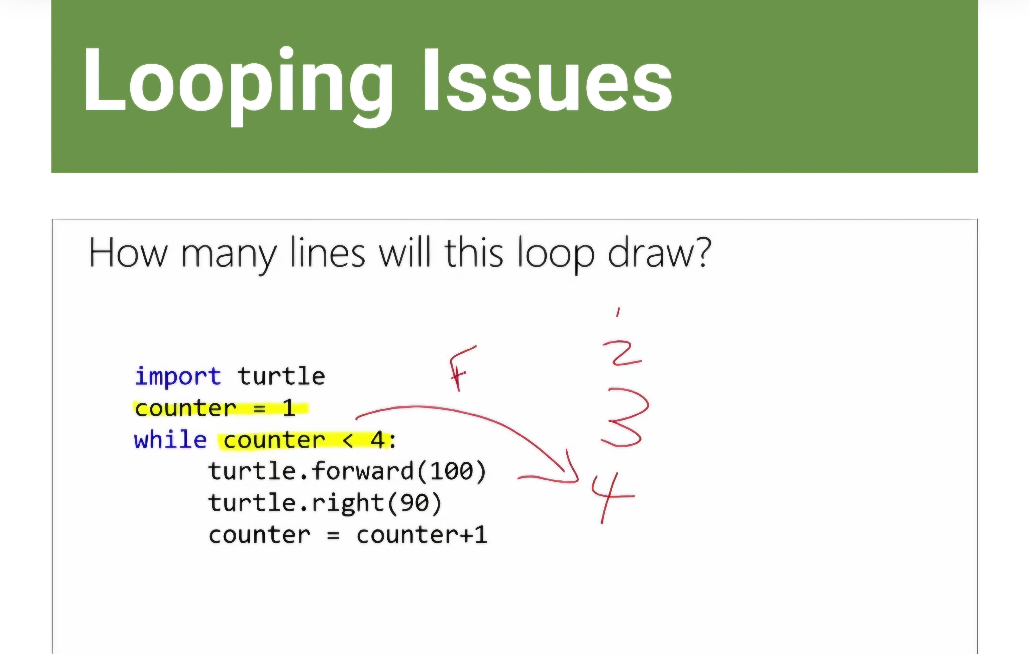
Loops allow you to repeat the same line of code as often as you want, while loops allow you to execute code until a particular condition is true
Mistakes are made throughout coding, with loops the problems can be harder to find as you could have gone through the loop a number of times before the error happens.
With while loops you have to make sure your condition changes or you could have an infinite loop with no way to end

Slide 34
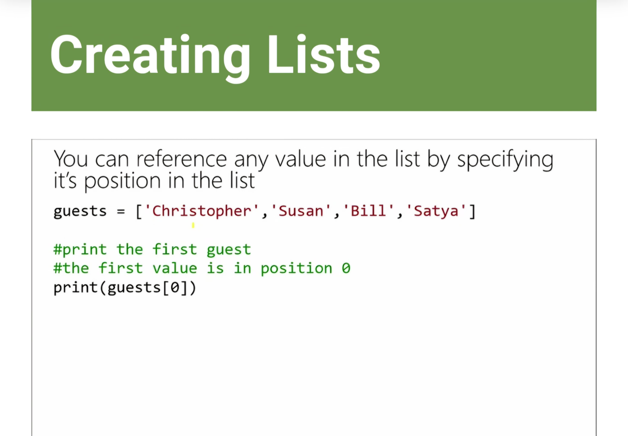
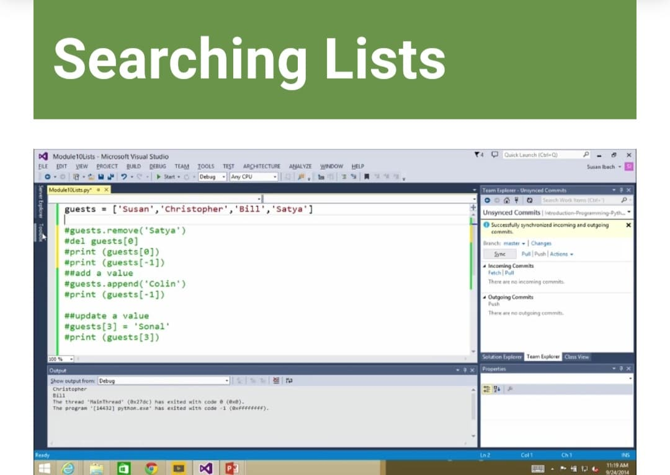
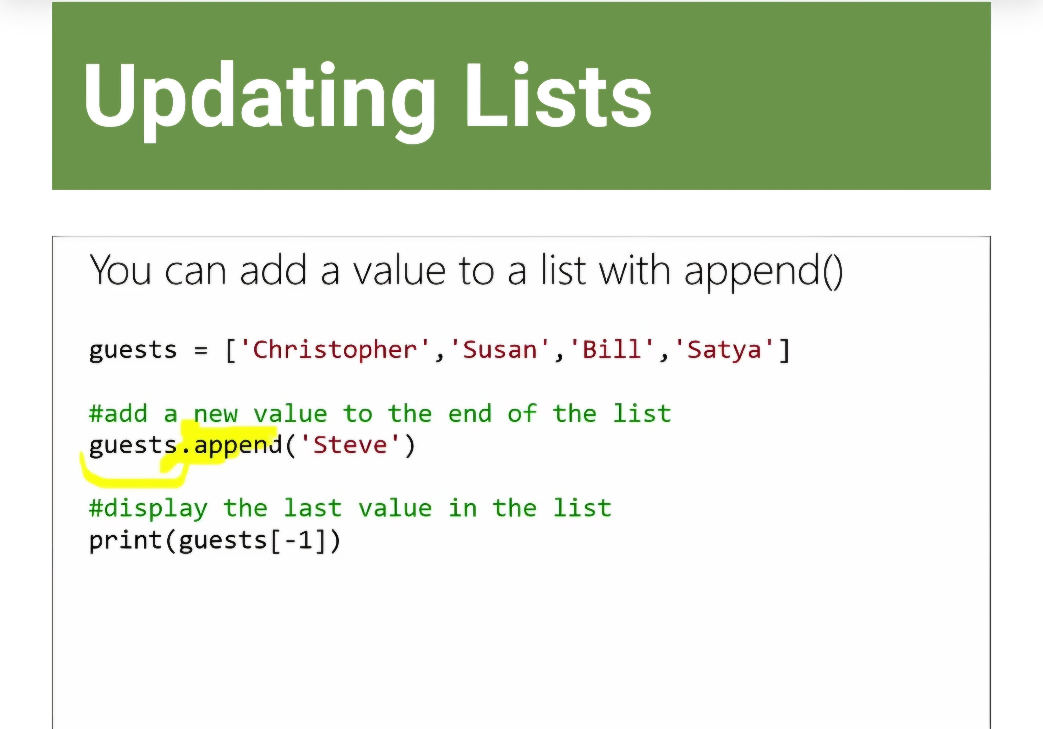
Lists allow you to store multiple values.
You can store different data types in a list but is not recommended as it can become confusing for both you and your code when getting data from your list later.
You can create empty list and add values to it later.
Lists count from 0, python does also allow you to count backward with-1 being the last value in the list.
For removing from your lists you have two options : 1. Remove()- Used when you know the value you want removed.
2. Del- Used when you know the index number if item you want removed.
You can change a value in a list by simply reassigning the value to a new one eg.list[0] = “new value”. The index is the position of a value in a list.
If you want the get the length of your list you use the len()function, useful for using in loops to search though the List.

Slide 35
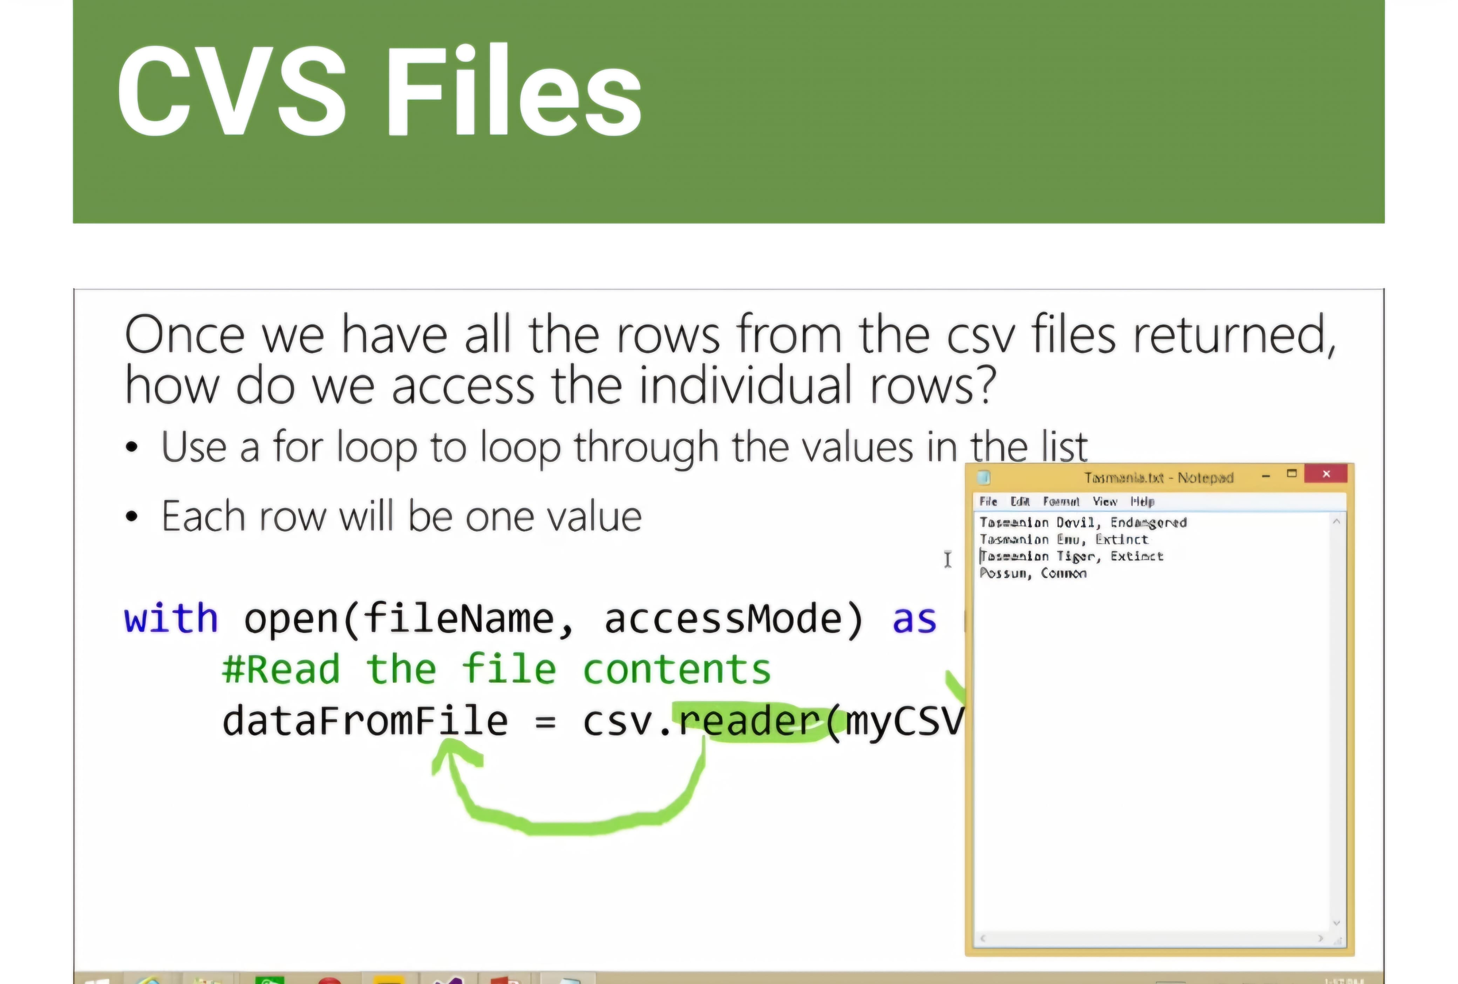
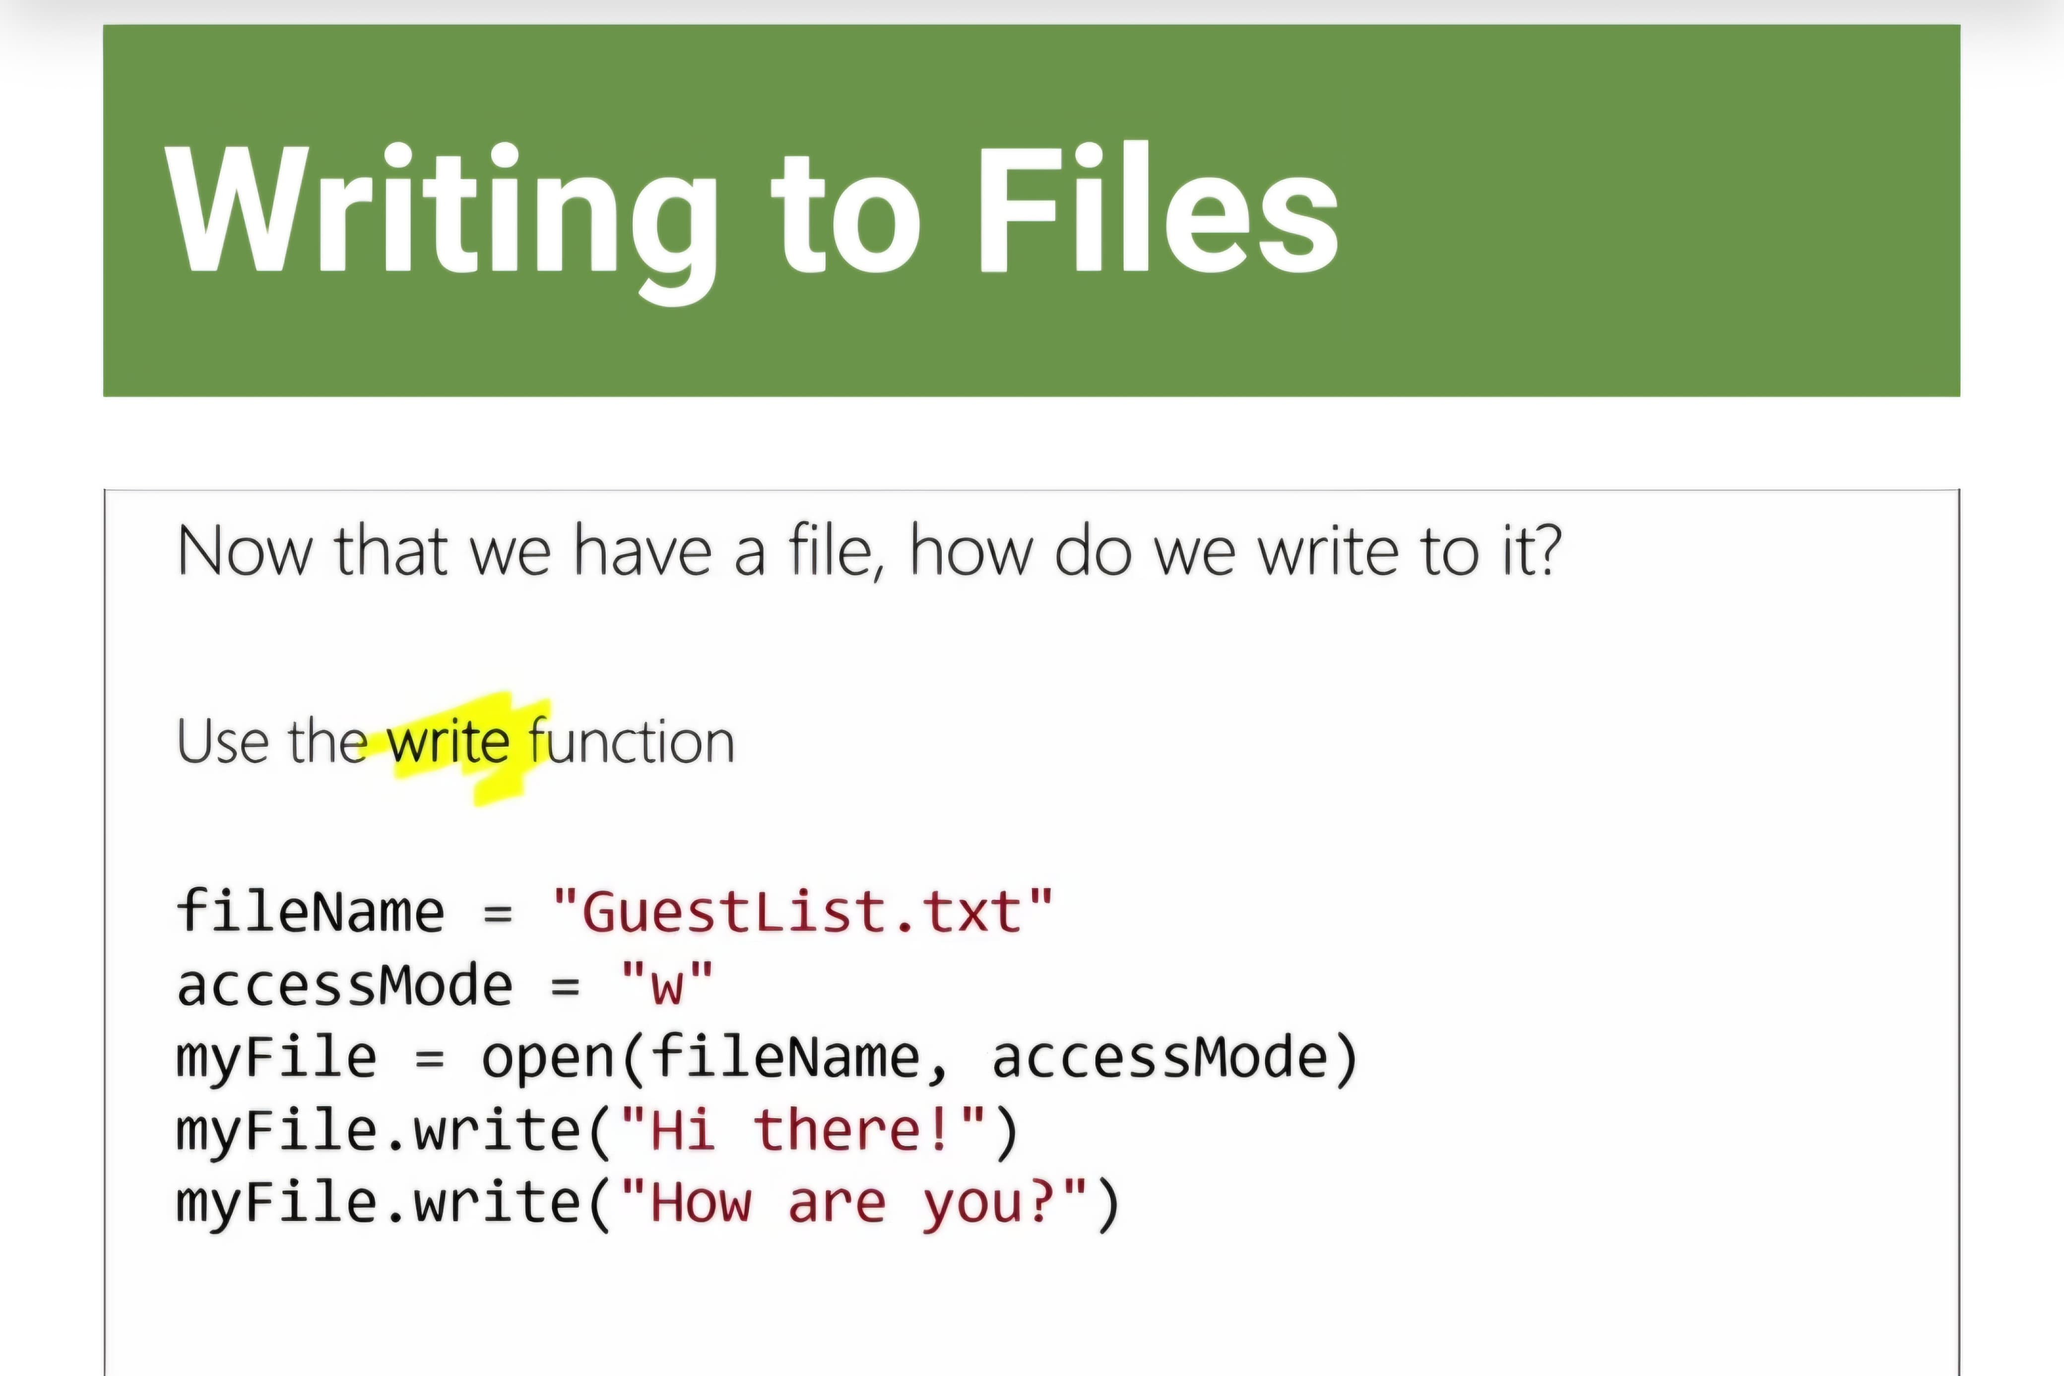
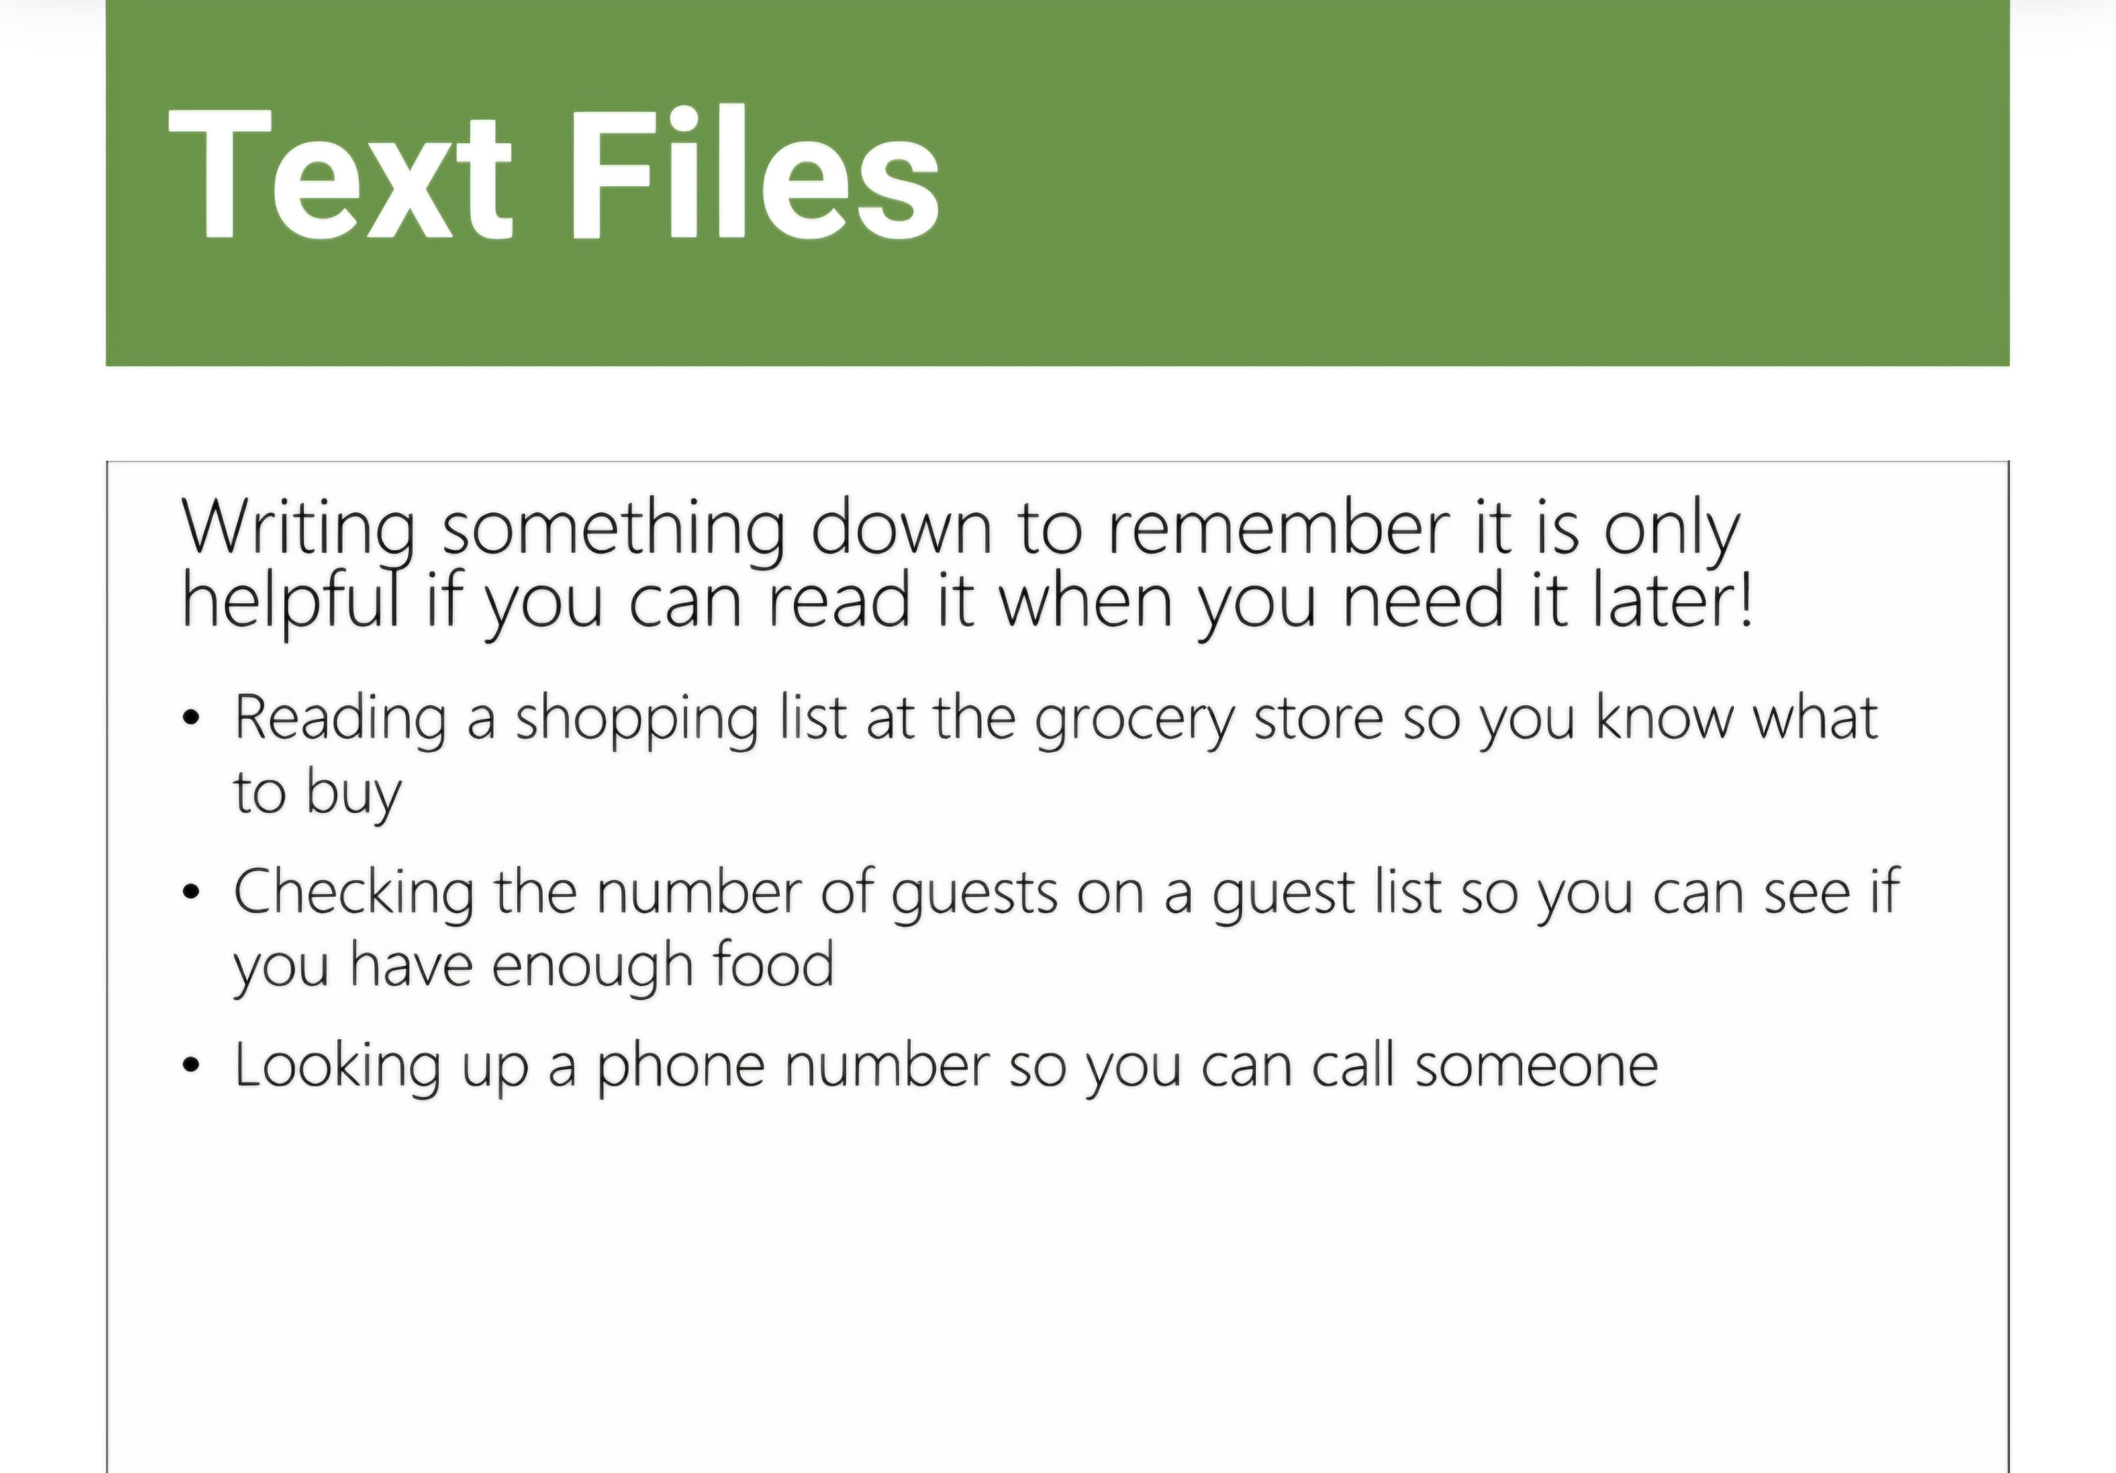
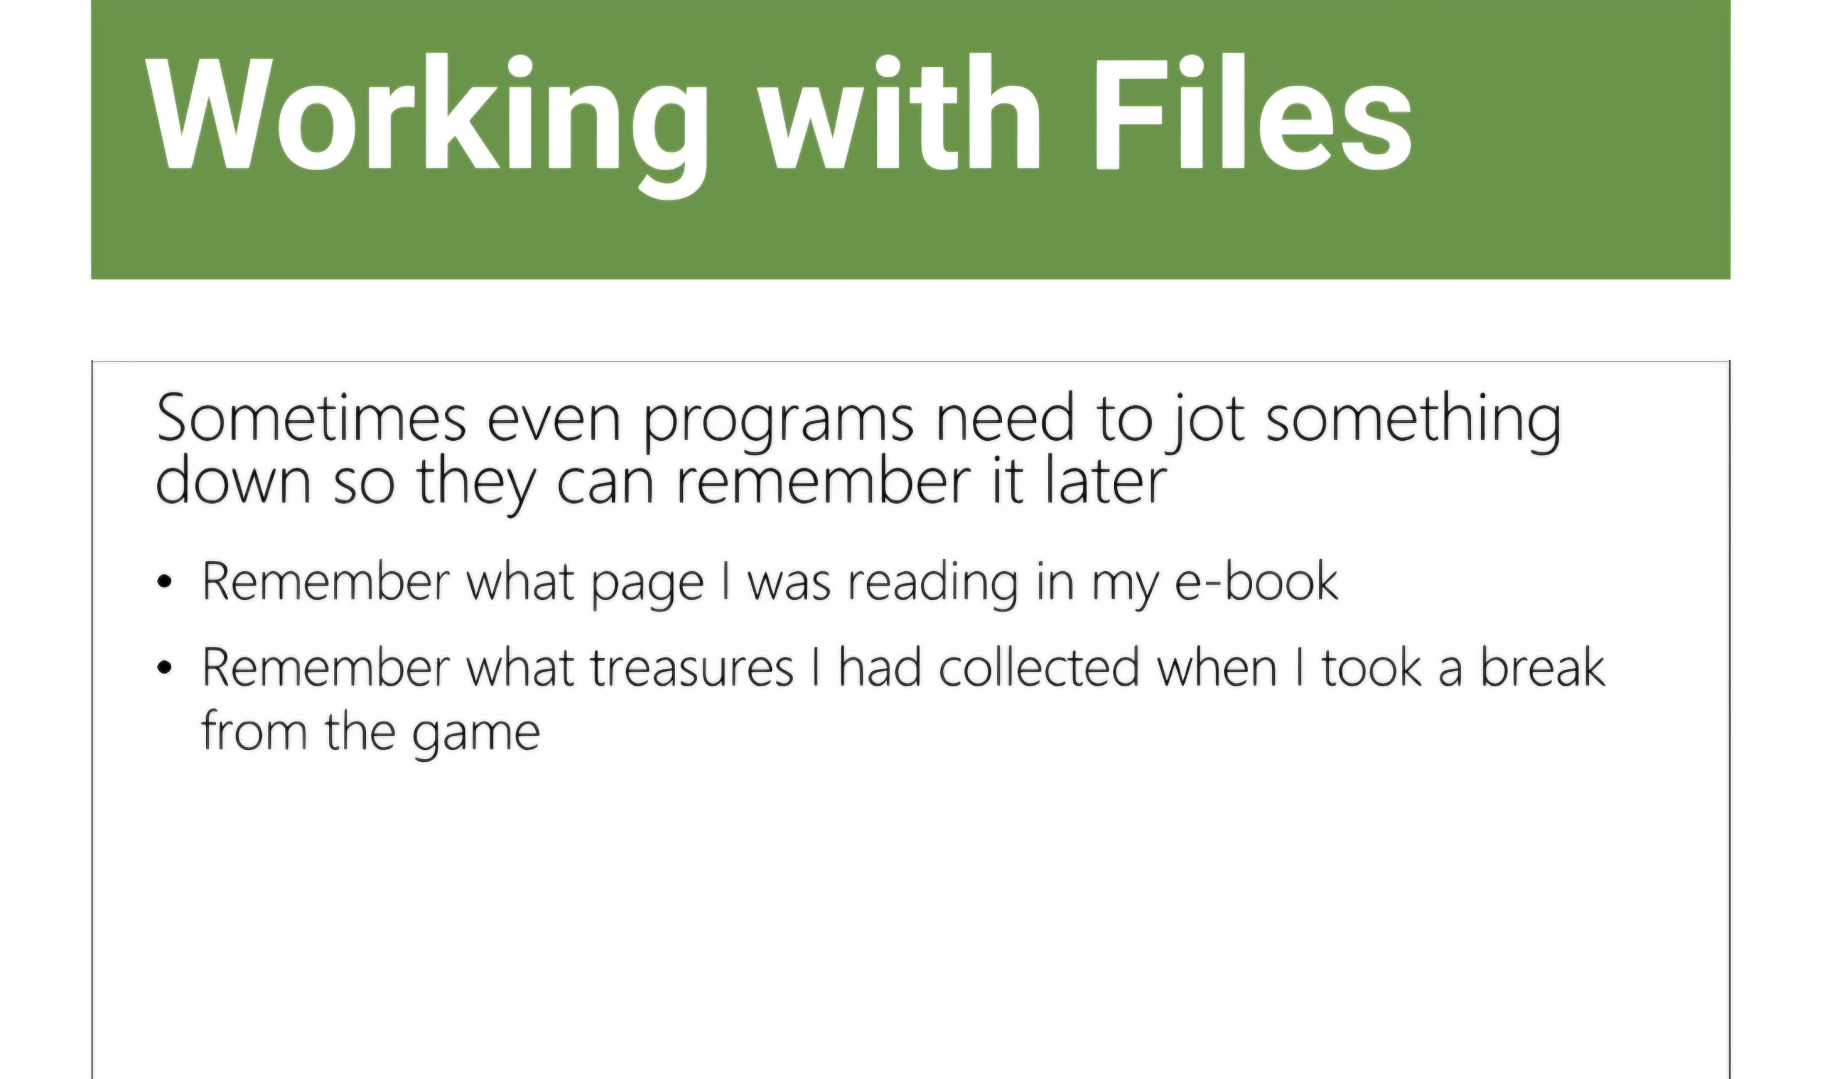
When creating files in your code you need to specify the file name including the file extension and the access mode.
The file extension is what type of file it is, .txt would be a text file.
Access mode is whether you can read or write to the file.
Access mode parameters:
r – read the file.
w – write to the file.
a – append to the existing file content.
A csv file is a comma separated values file.
When using the write of function to write to a file you need to use \n to write on a new line.
Remember you need to close files after opening them.

Slide 36
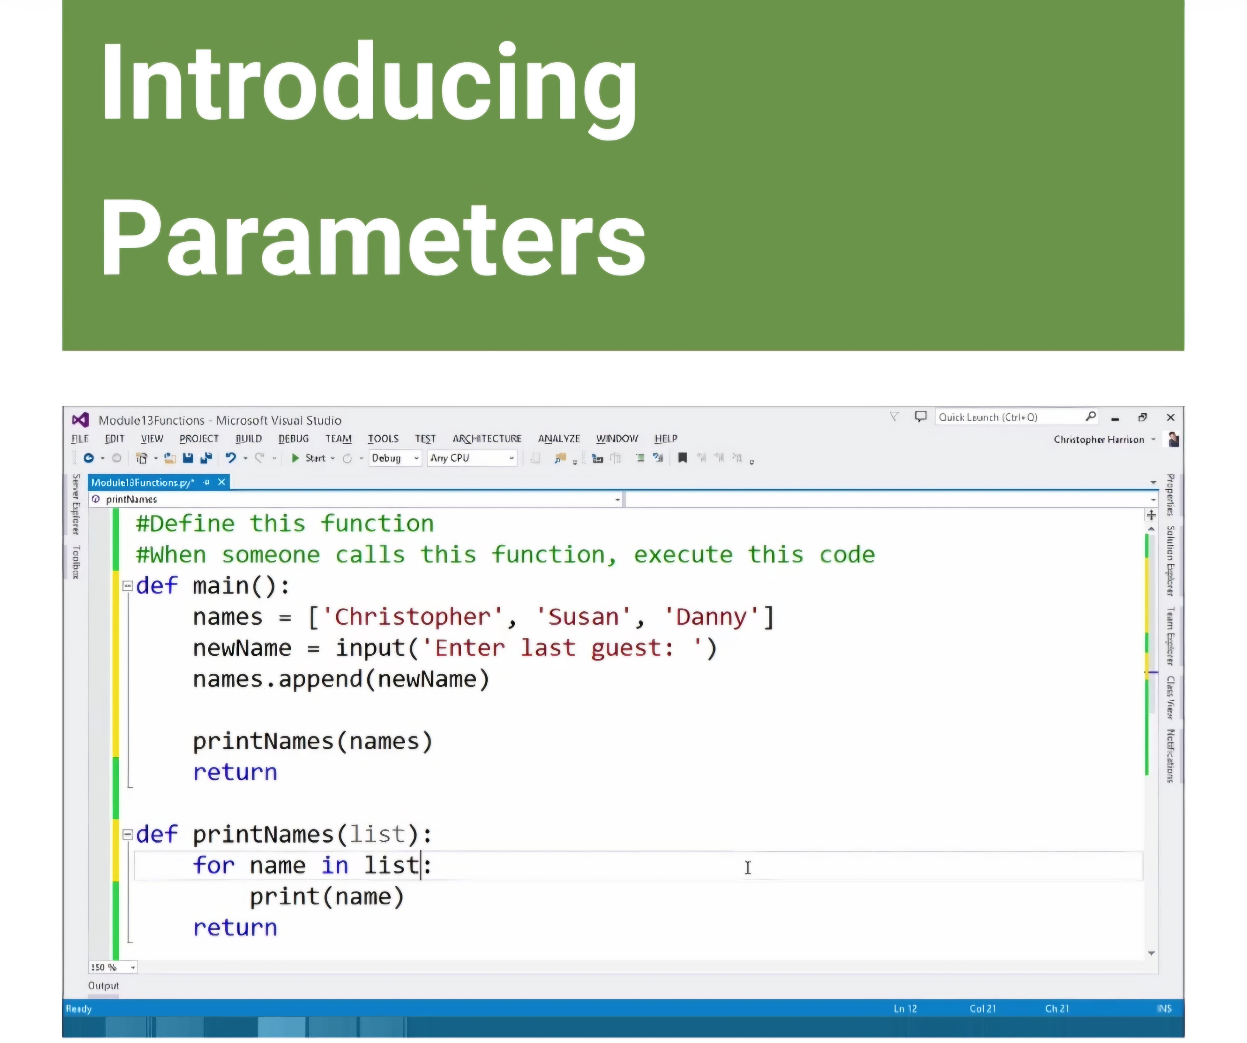
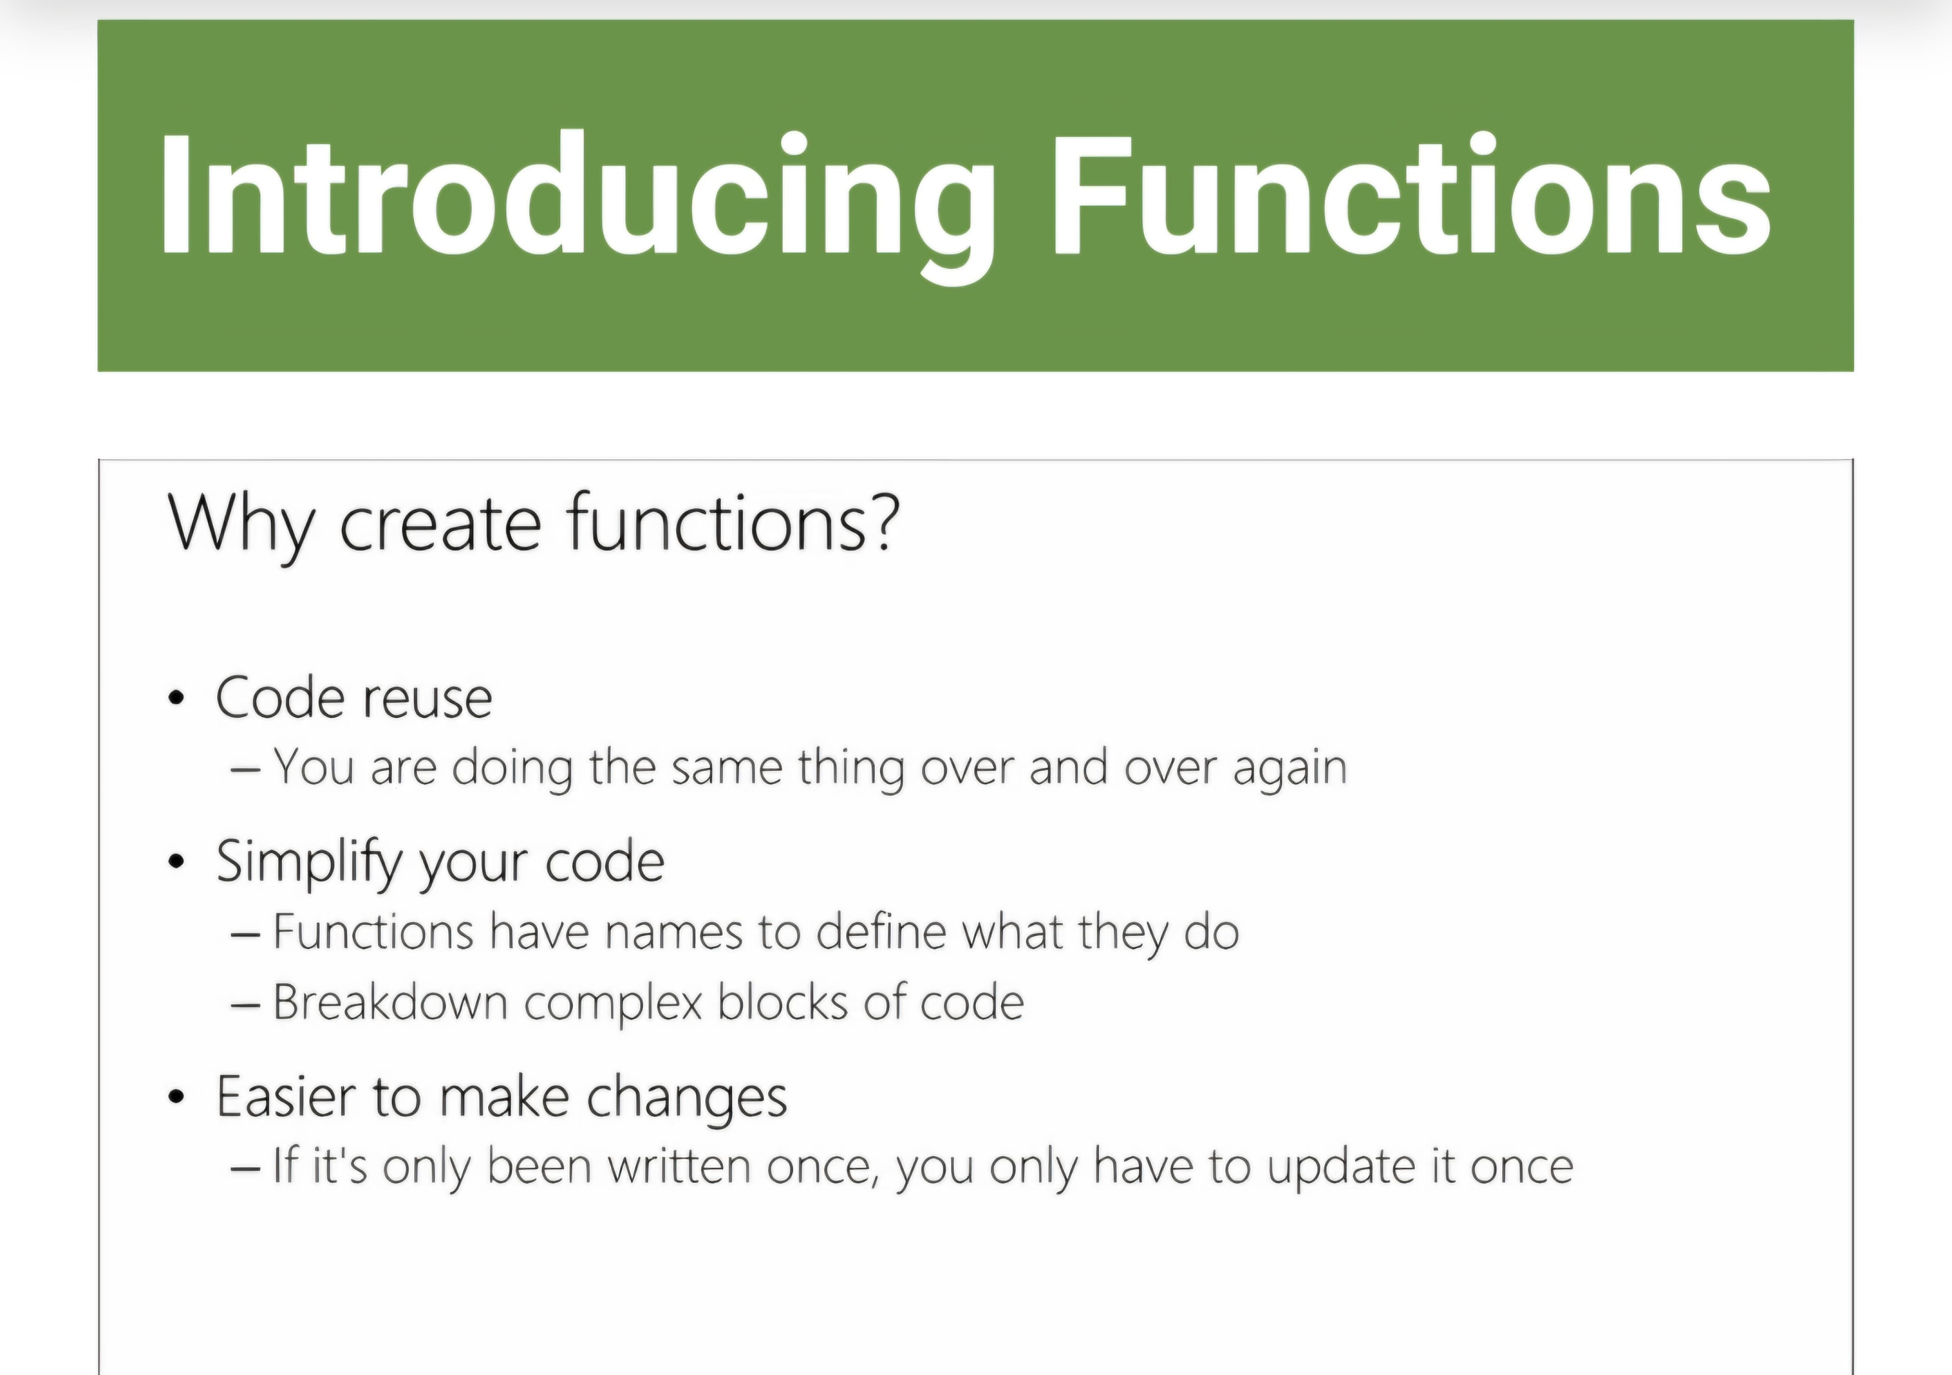
For reading from a file you open it the same as you would if you were creating or writing to the file. You then use the read function, to read al of its contents or you could use readline to read one line at a time. There is a library for helping reading csv files that provides many functions that you would otherwise have to create yourself. As there is no standard for csv files sometimes the separator or delimiter could be a semicolon or some other indicator instead of a comma and your program will need to know what the separator is . The with statement will automatically close a file after the code is finished and if an error occurred when writing or reading from the file.

Slide 37
Indentation can be used to make code easier to read and relate codes together. Indentation will not affect the way your code appears when you run the project.
Visual studio will automatically add colour to certain aspects of code to help the readability of code.
Code is defined inside a code block. You define a code block by inserting ‘sub’ or ‘function’ followed by ‘end sub’ or ‘end function’. Alternatively, you can type ‘module’ followed by ‘end module’. Your code should appear between these.=
It is important to place your message within double quotation marks in your code.

Slide 38
A function is a method or reusable section of code with a name you can call when you need it to perform a task, without having to rewrite the code again and again.
To create a function, you use the def keyword and give you function a name, and write code in the body of the function for what its going to do.
Parameters are pieces of data you pass into a function, they often behave like variables inside the function
Return passes back a value, variable.

Slide 39
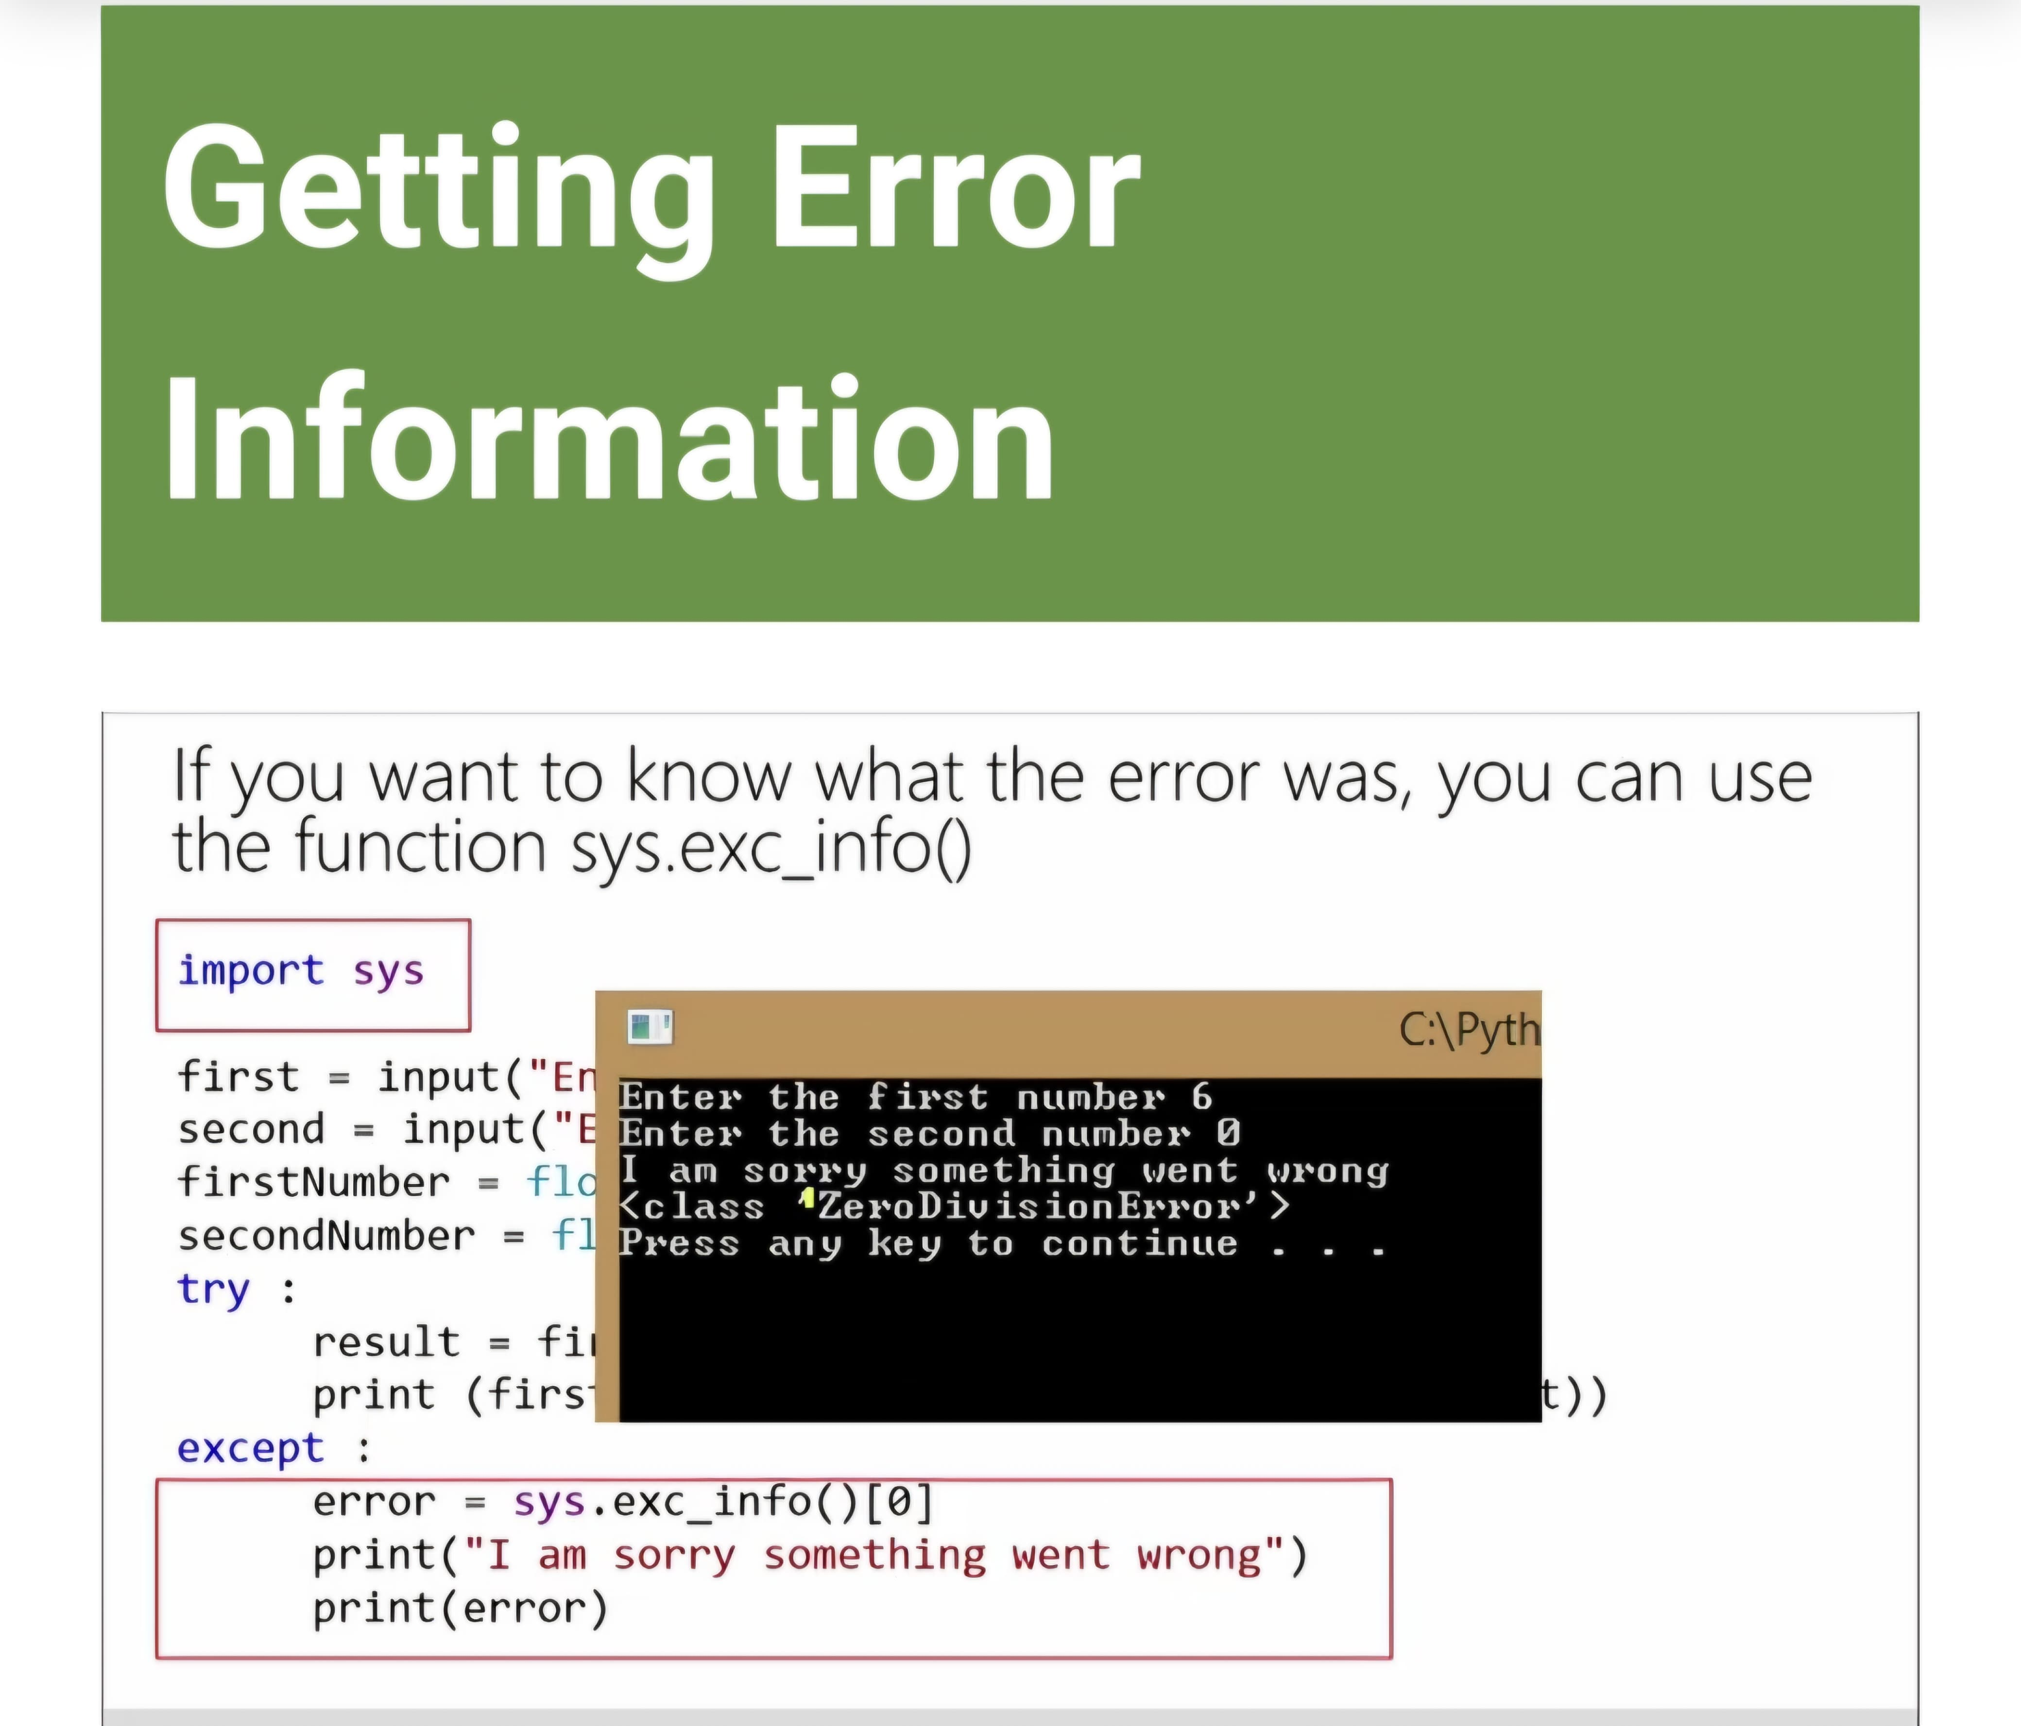
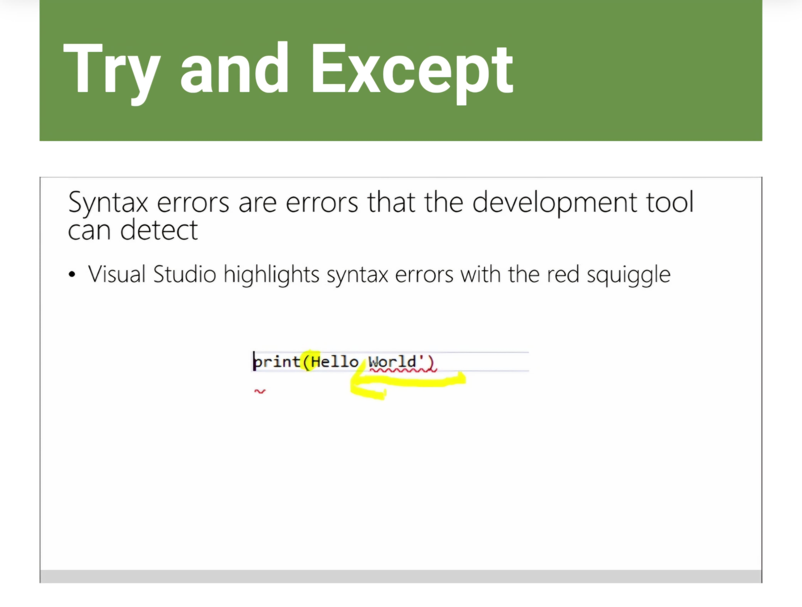
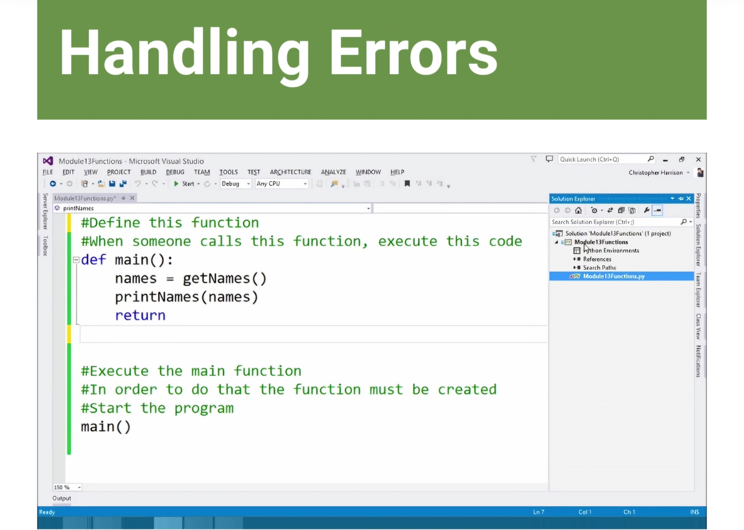
Syntax error are highlighted with a red squiggly line. The same as MS word highlighting spelling mistake.
Logic errors are syntactically correct, but they mean that your program doesn’t do what you wanted it to do. Logic errors can be harder to find, you should often have to step through code with the debugger.
Runtime errors occur when the code works but something out of the ordinary crashes the code.
A key/ exception block involves trying a bit of code that may cause an error and if it fails, the exception is what to do in that event.
If you want to see or display what error happened you can use the sys.exc_info() to find it you will need to import the sys library.

Slide 40
So these all are the things I studied in the certification course. It includes every basics to important parts of tthhe python programming.

Slide 41
Post Certification Options.
Advanced Programming Courses Enroll in advanced Python or full-stack development courses to deepen your skills.
Specialization Paths Explore specialized fields such as:
Data Science
Machine Learning & AI
Web Development (using Django/Flask)
Automation & Scripting
Cybersecurity
Internships & Entry-Level Jobs Apply for internships, junior developer roles, or freelance projects to gain real-world experience.

Slide 42
Build Personal Projects Start your own portfolio by developing applications, websites, or automation tools to showcase your skills.
Higher Education Use the diploma as a stepping stone to pursue a degree in Computer Science, Software Engineering, or related fields.
Contribute to Open Source Join the developer community by contributing to open-source projects to gain exposure and network with professionals.
Increased Confidence in Coding Build self-assurance in writing and debugging Python code independently.
Improved Scalability of Learning Easily transition into more complex topics like APIs, databases, or cloud development.
Apply Skills to Real-World Projects Use your knowledge to develop applications, automation scripts, and tools with practical value.

Slide 43
Conclusion.
The Diploma in Python Programming is a valuable starting point for anyone looking to build a successful career in the tech industry. It provides a solid foundation in one of the most widely used programming languages, opening doors to a variety of fields such as web development, data science, automation, and artificial intelligence. Through this course, I have gained essential coding skills, real-world problem-solving abilities, and the confidence to take on more advanced challenges. This certification not only enhances my knowledge but also strengthens my position in a competitive job market. I am excited to continue learning and growing in this dynamic and ever-evolving field.

Slide 44
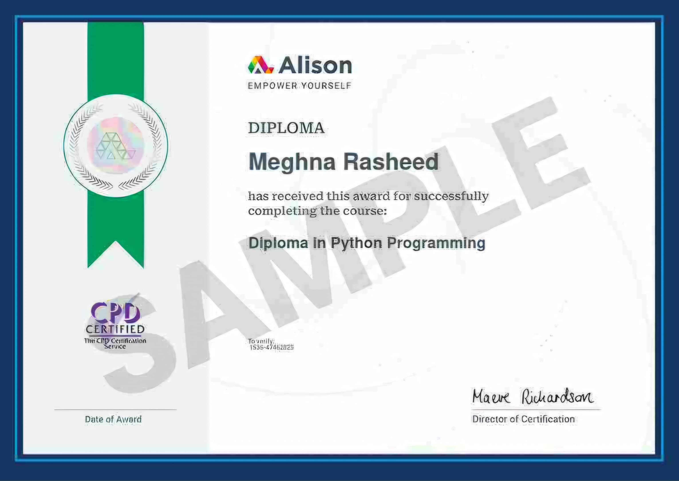
Diploma In Python Programming – Certificate.

Slide 45
THANK YOU.

